Slide 1
Classes: A Deeper Look
Based on Chapter 9 of C++ How to Program, 10/e

Slide 2
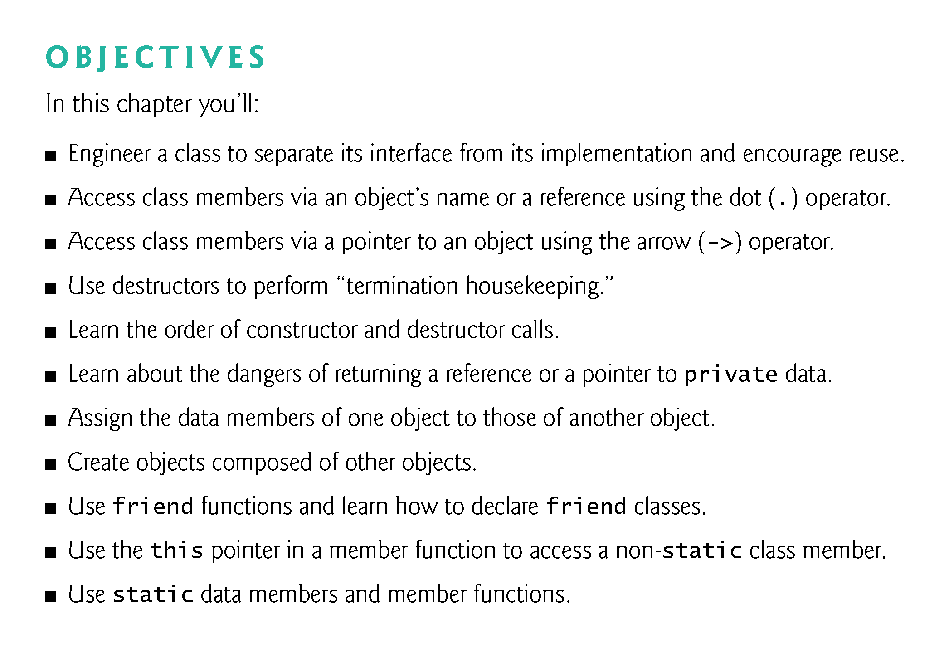

Slide 3
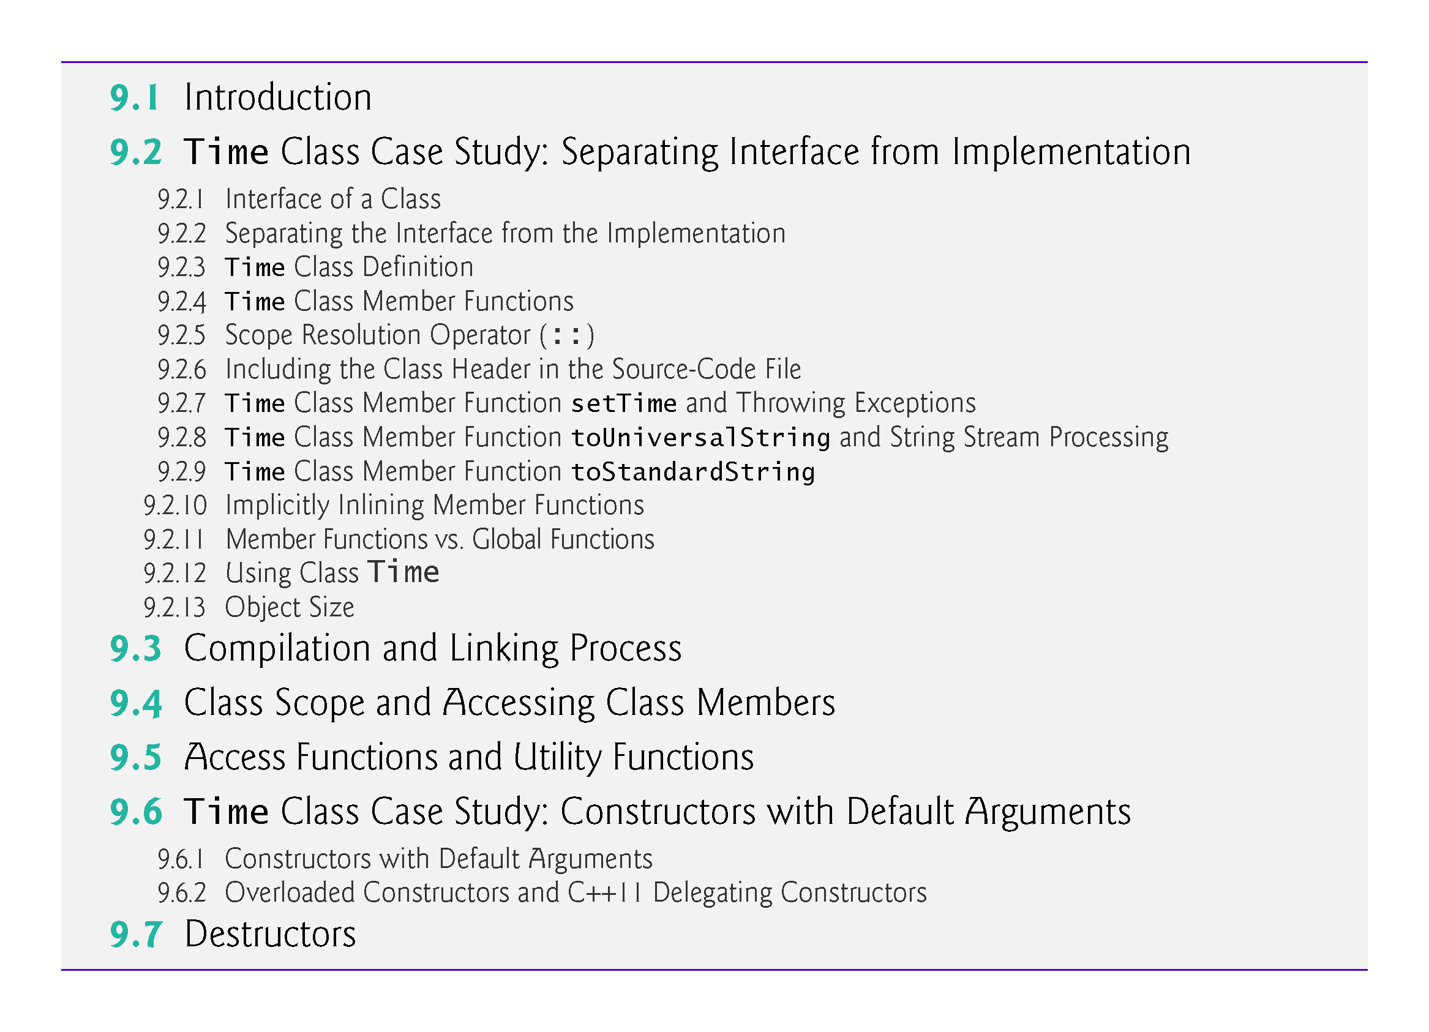

Slide 4
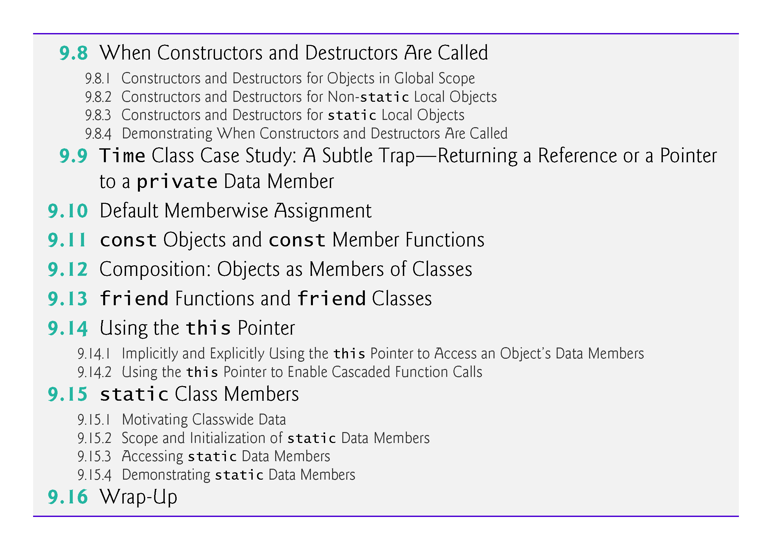

Slide 5
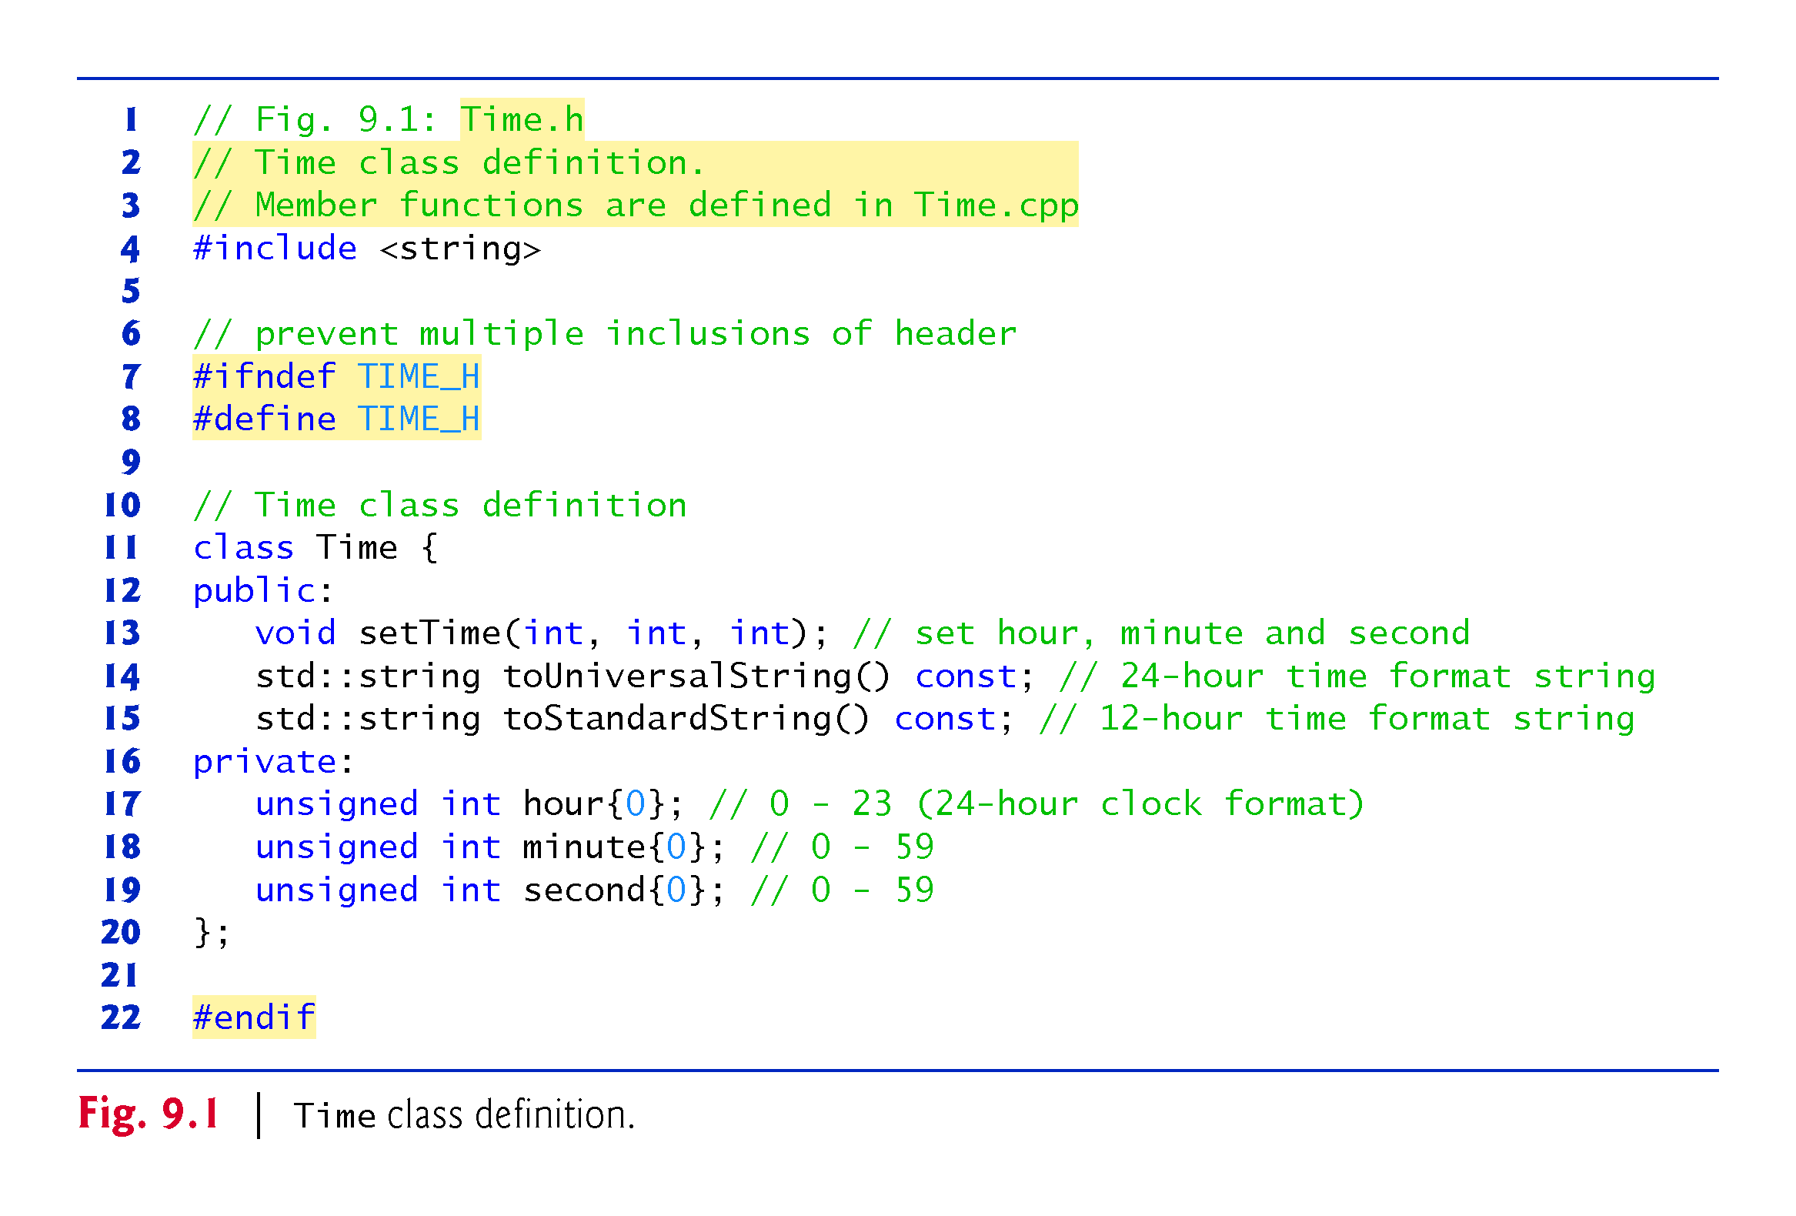

Slide 6
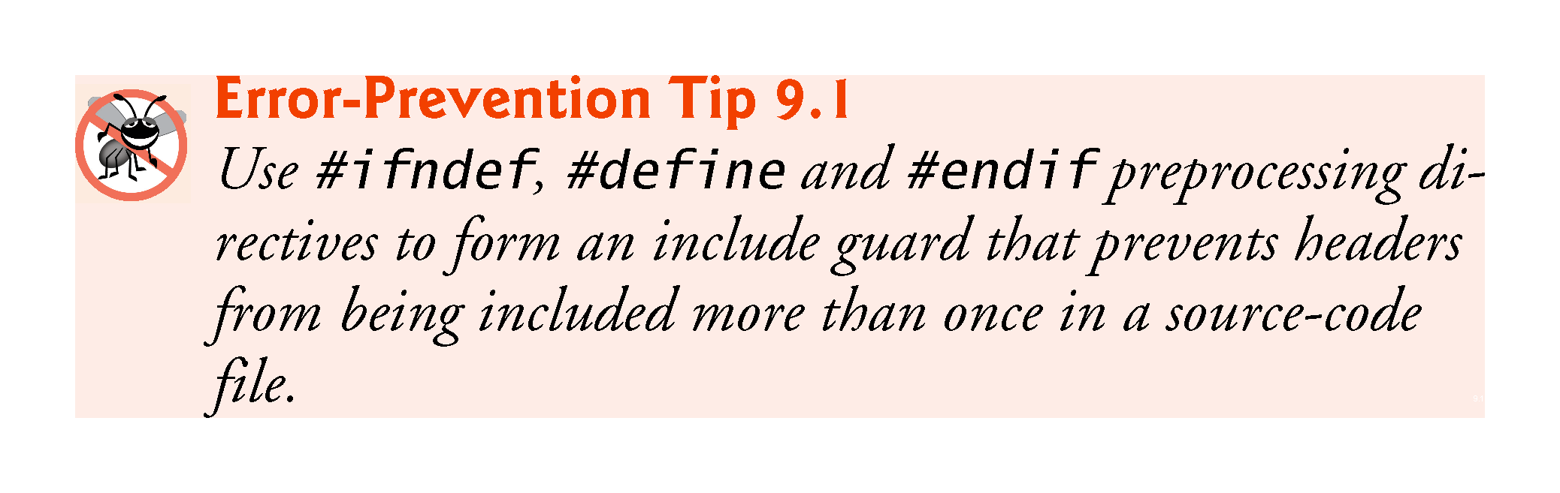

Slide 7
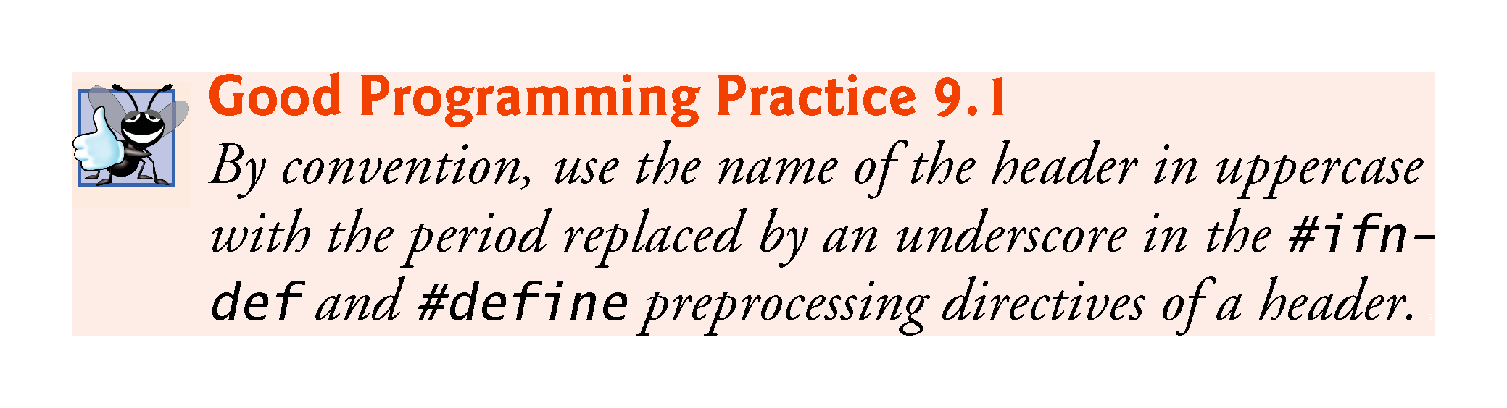

Slide 8
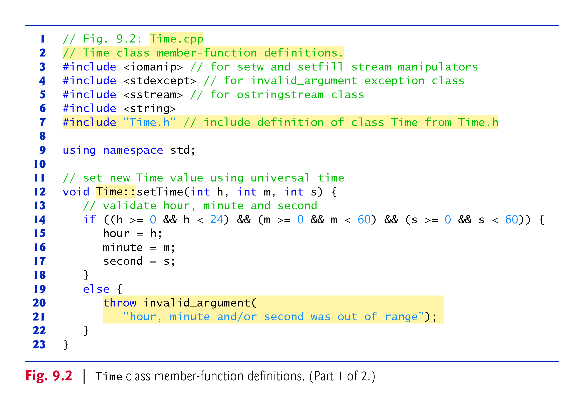

Slide 9
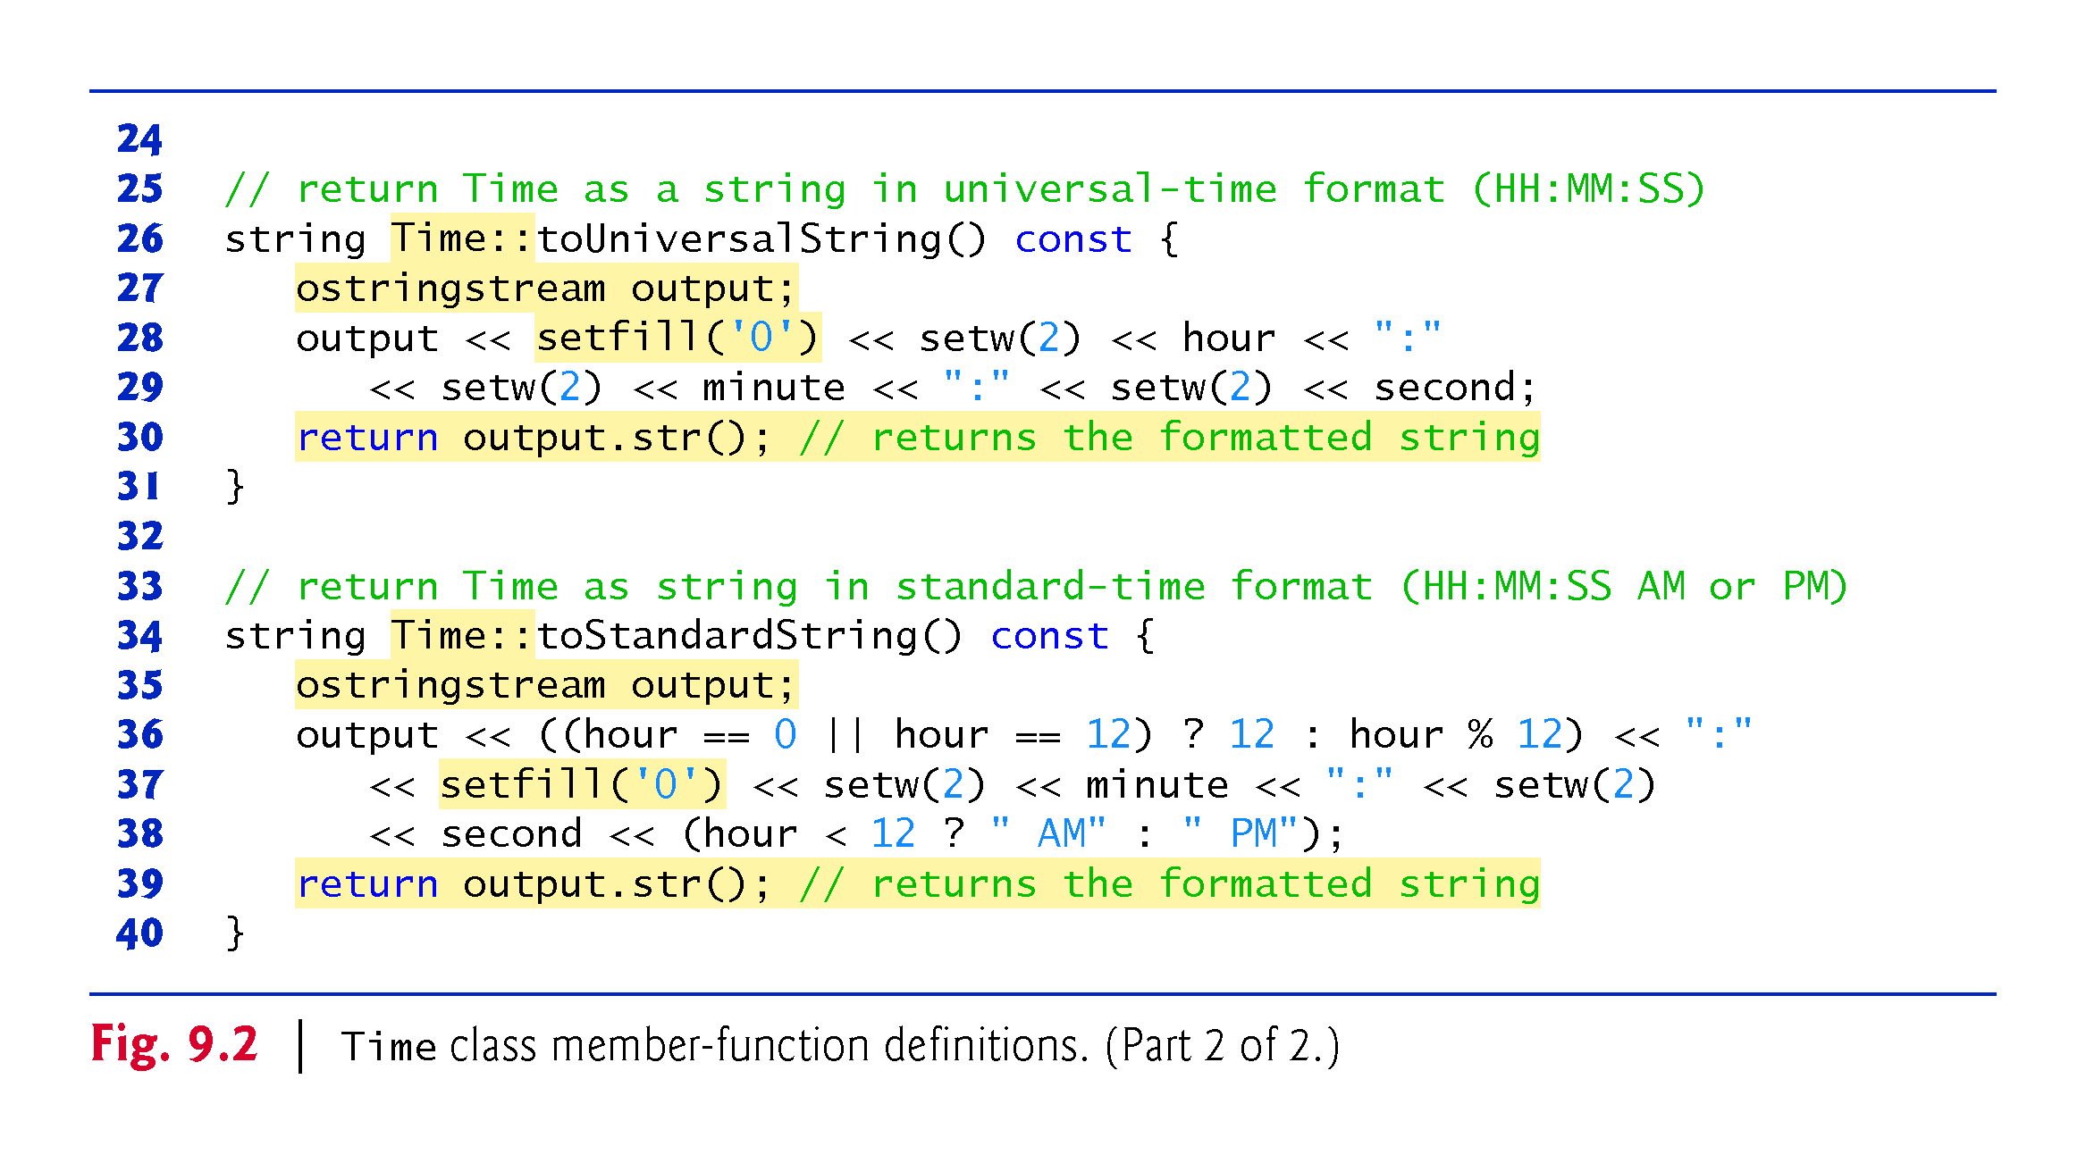

Slide 10
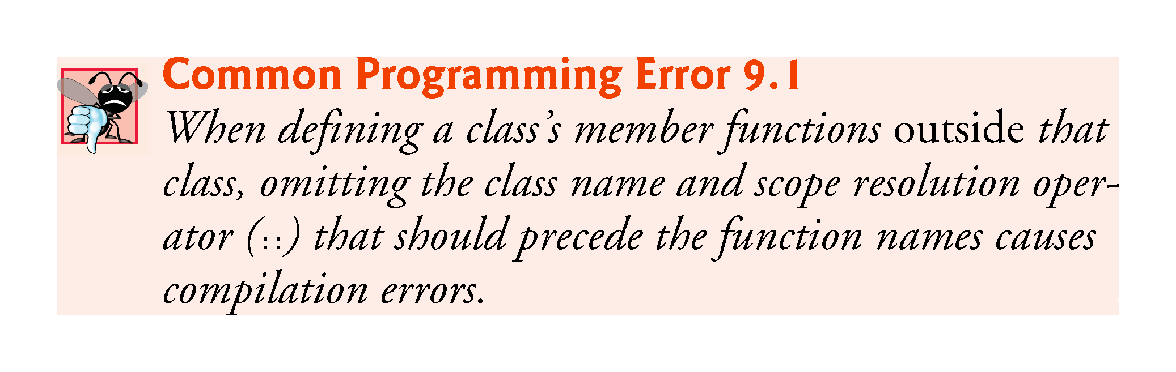

Slide 11
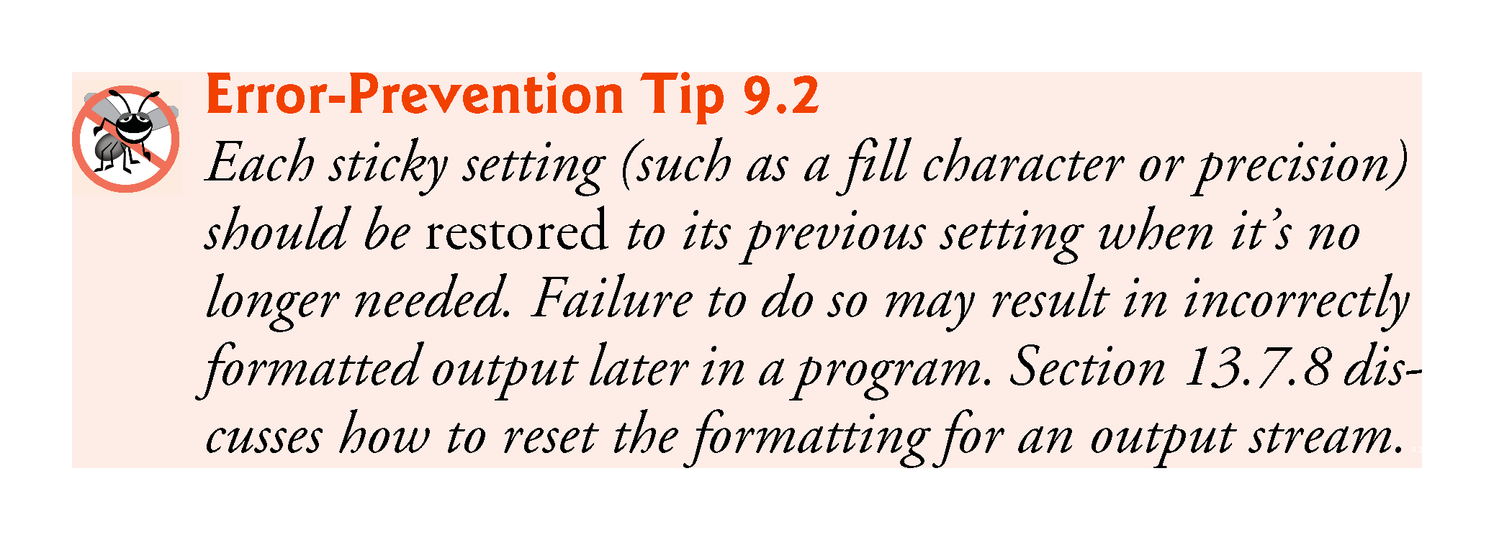

Slide 12
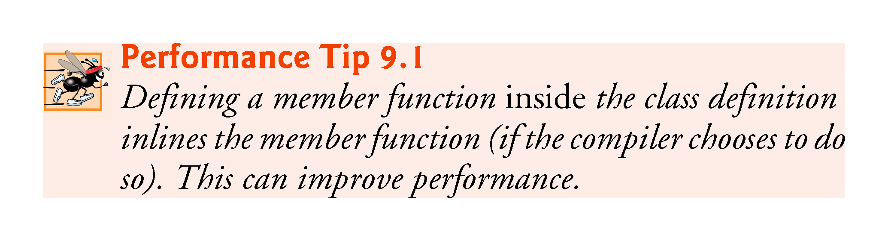

Slide 13
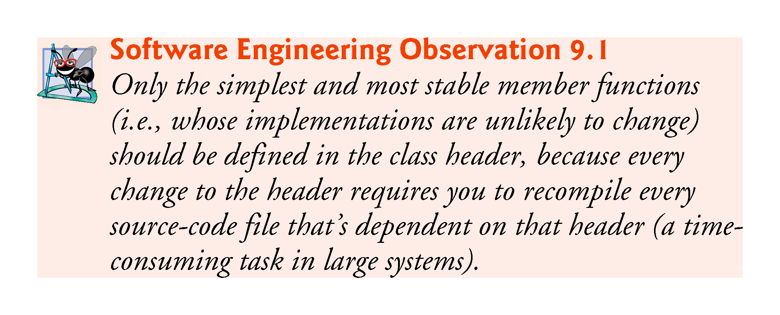

Slide 14
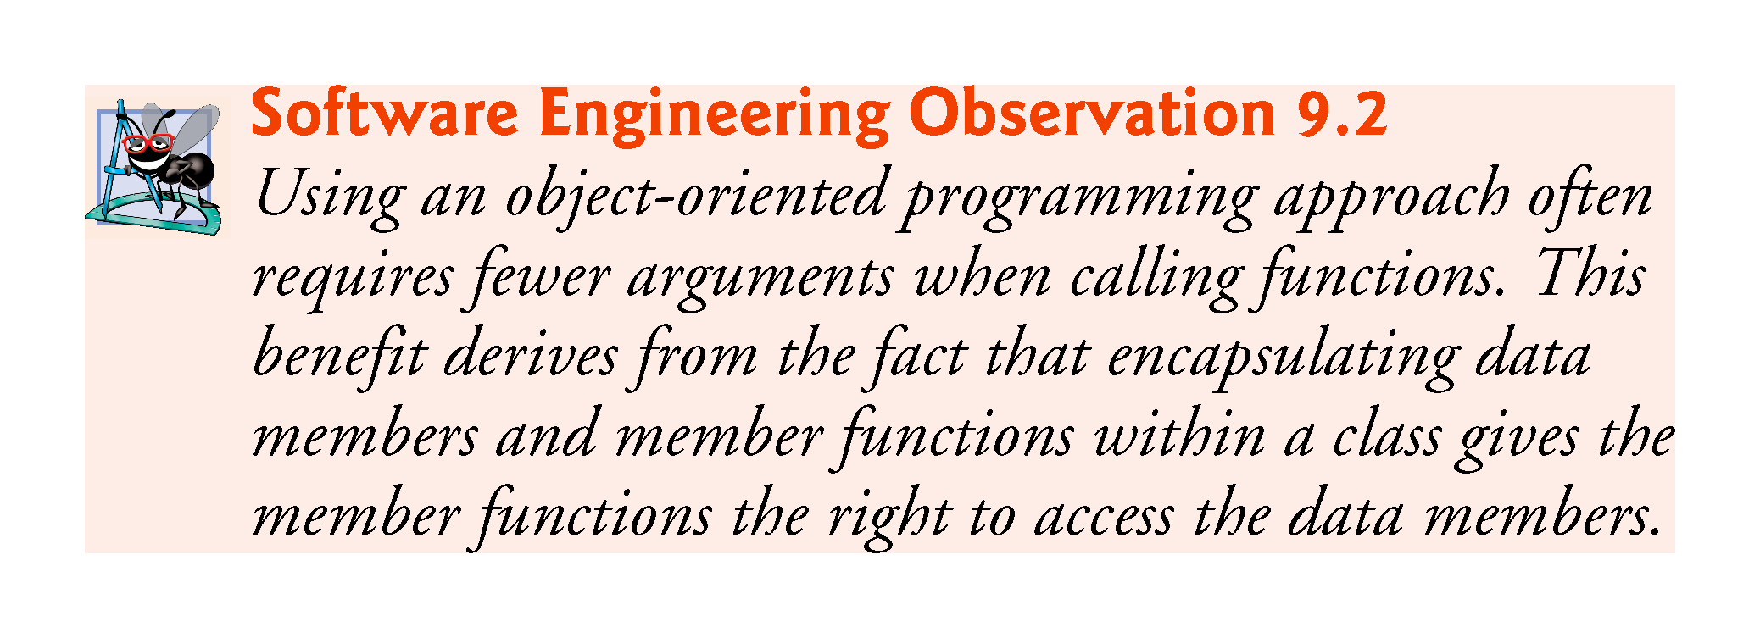

Slide 15
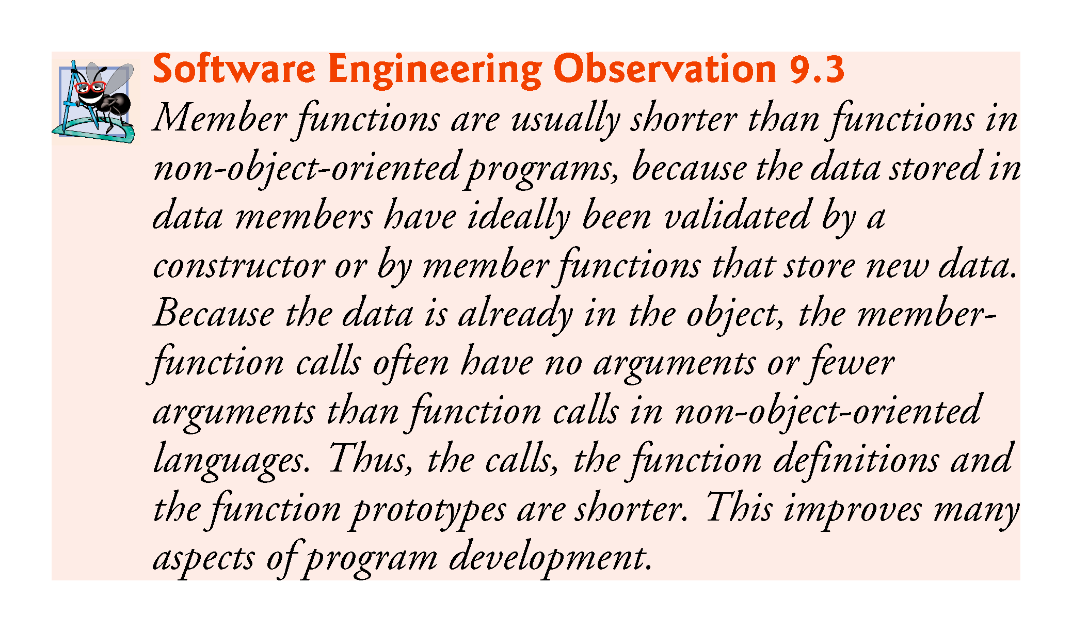

Slide 16
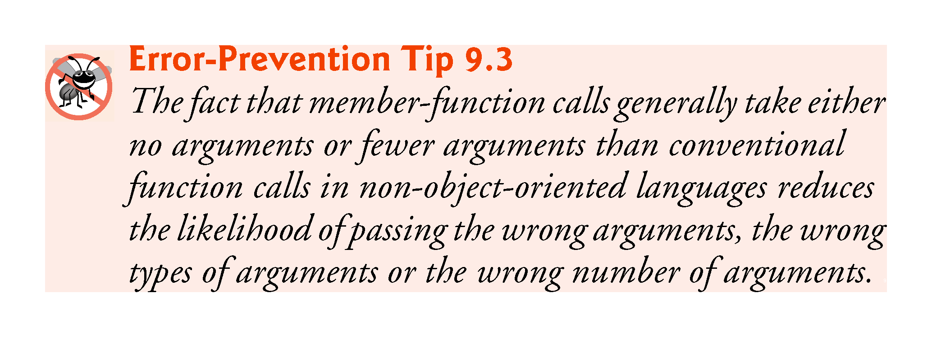

Slide 17
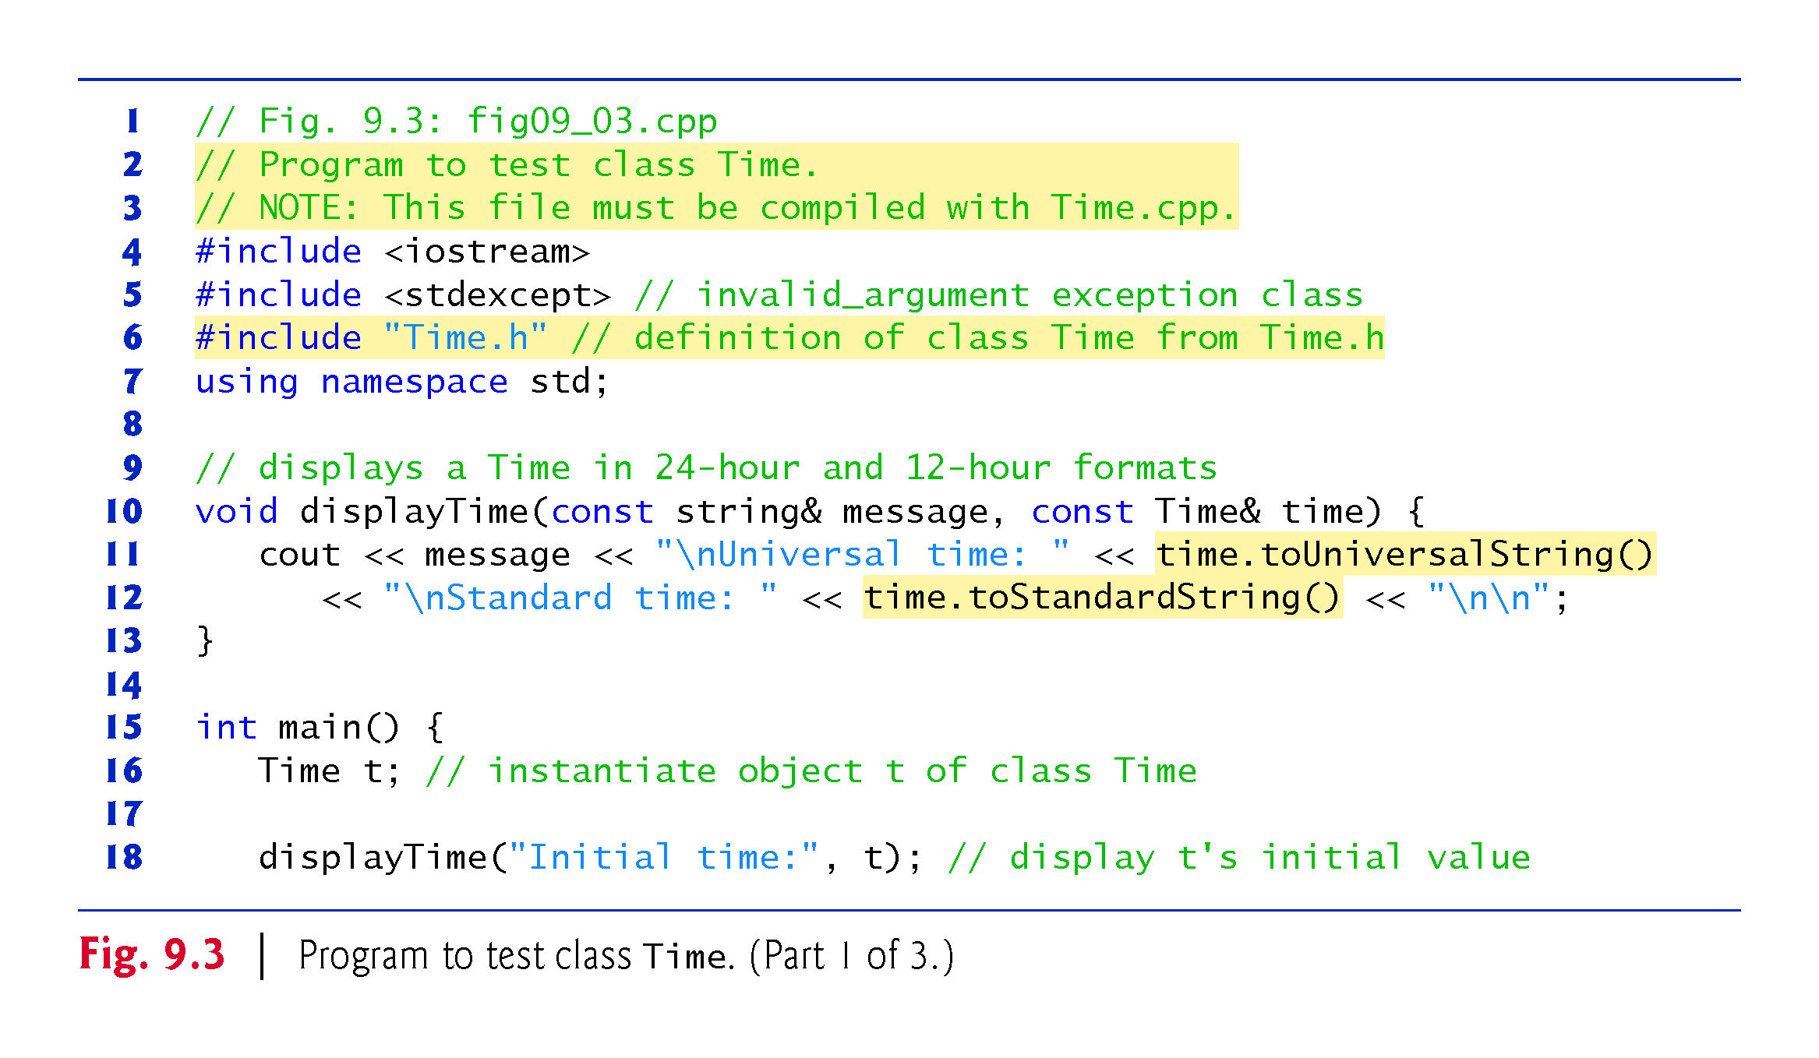

Slide 18
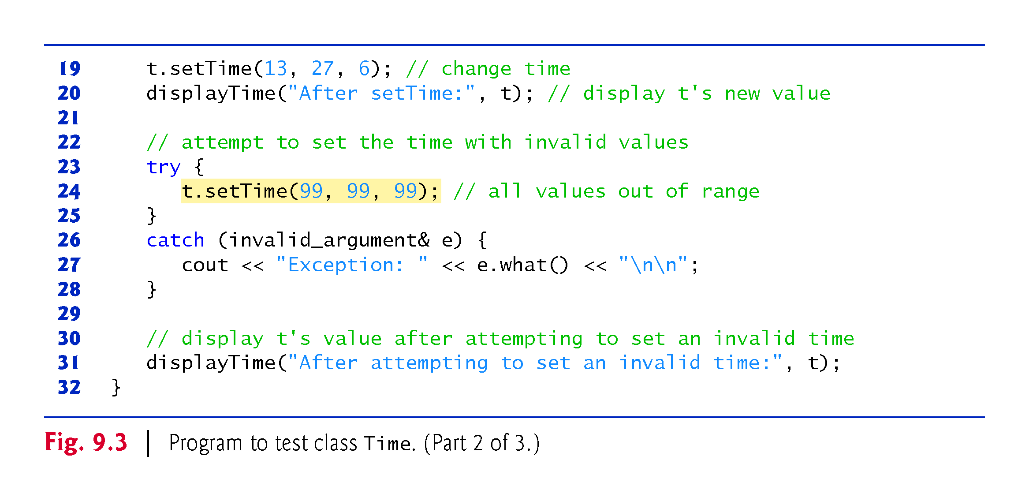
Notes:
Ob: Anything inside try/catch does not change the values of the members of t

Slide 19
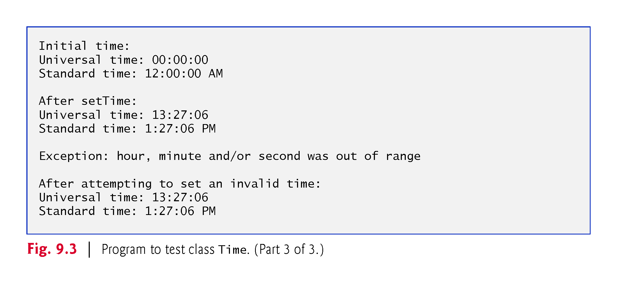

Slide 20
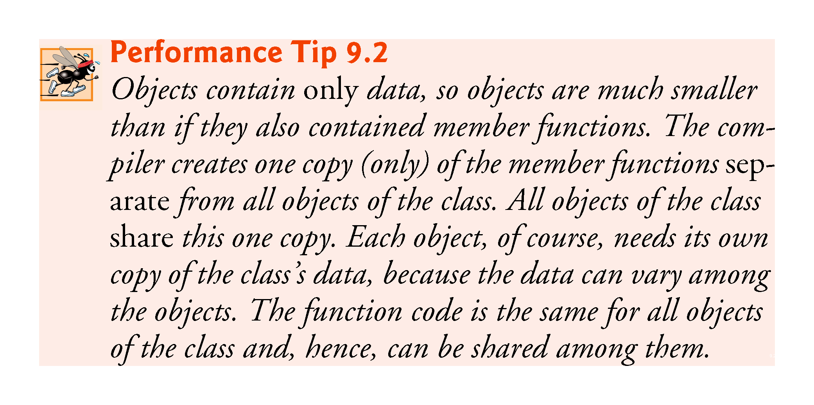

Slide 21
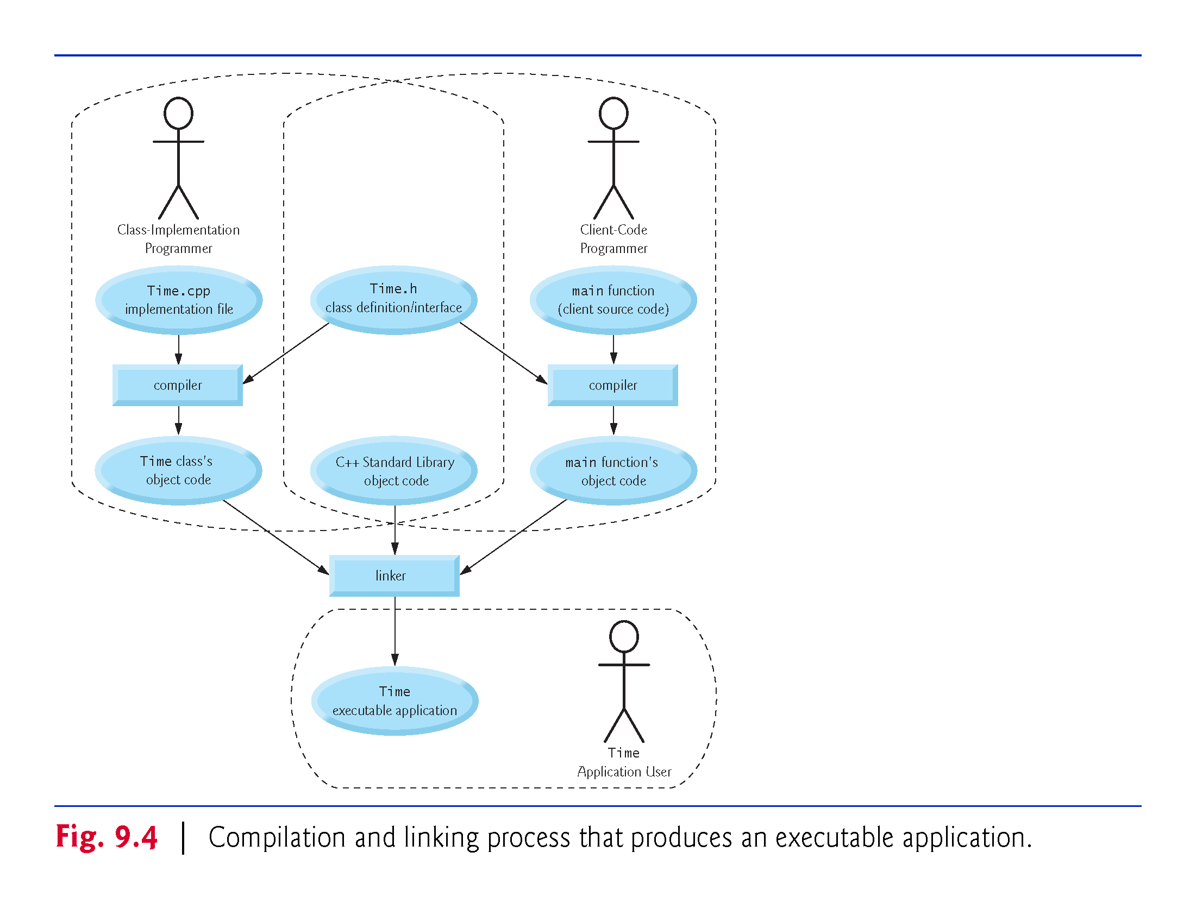

Slide 22
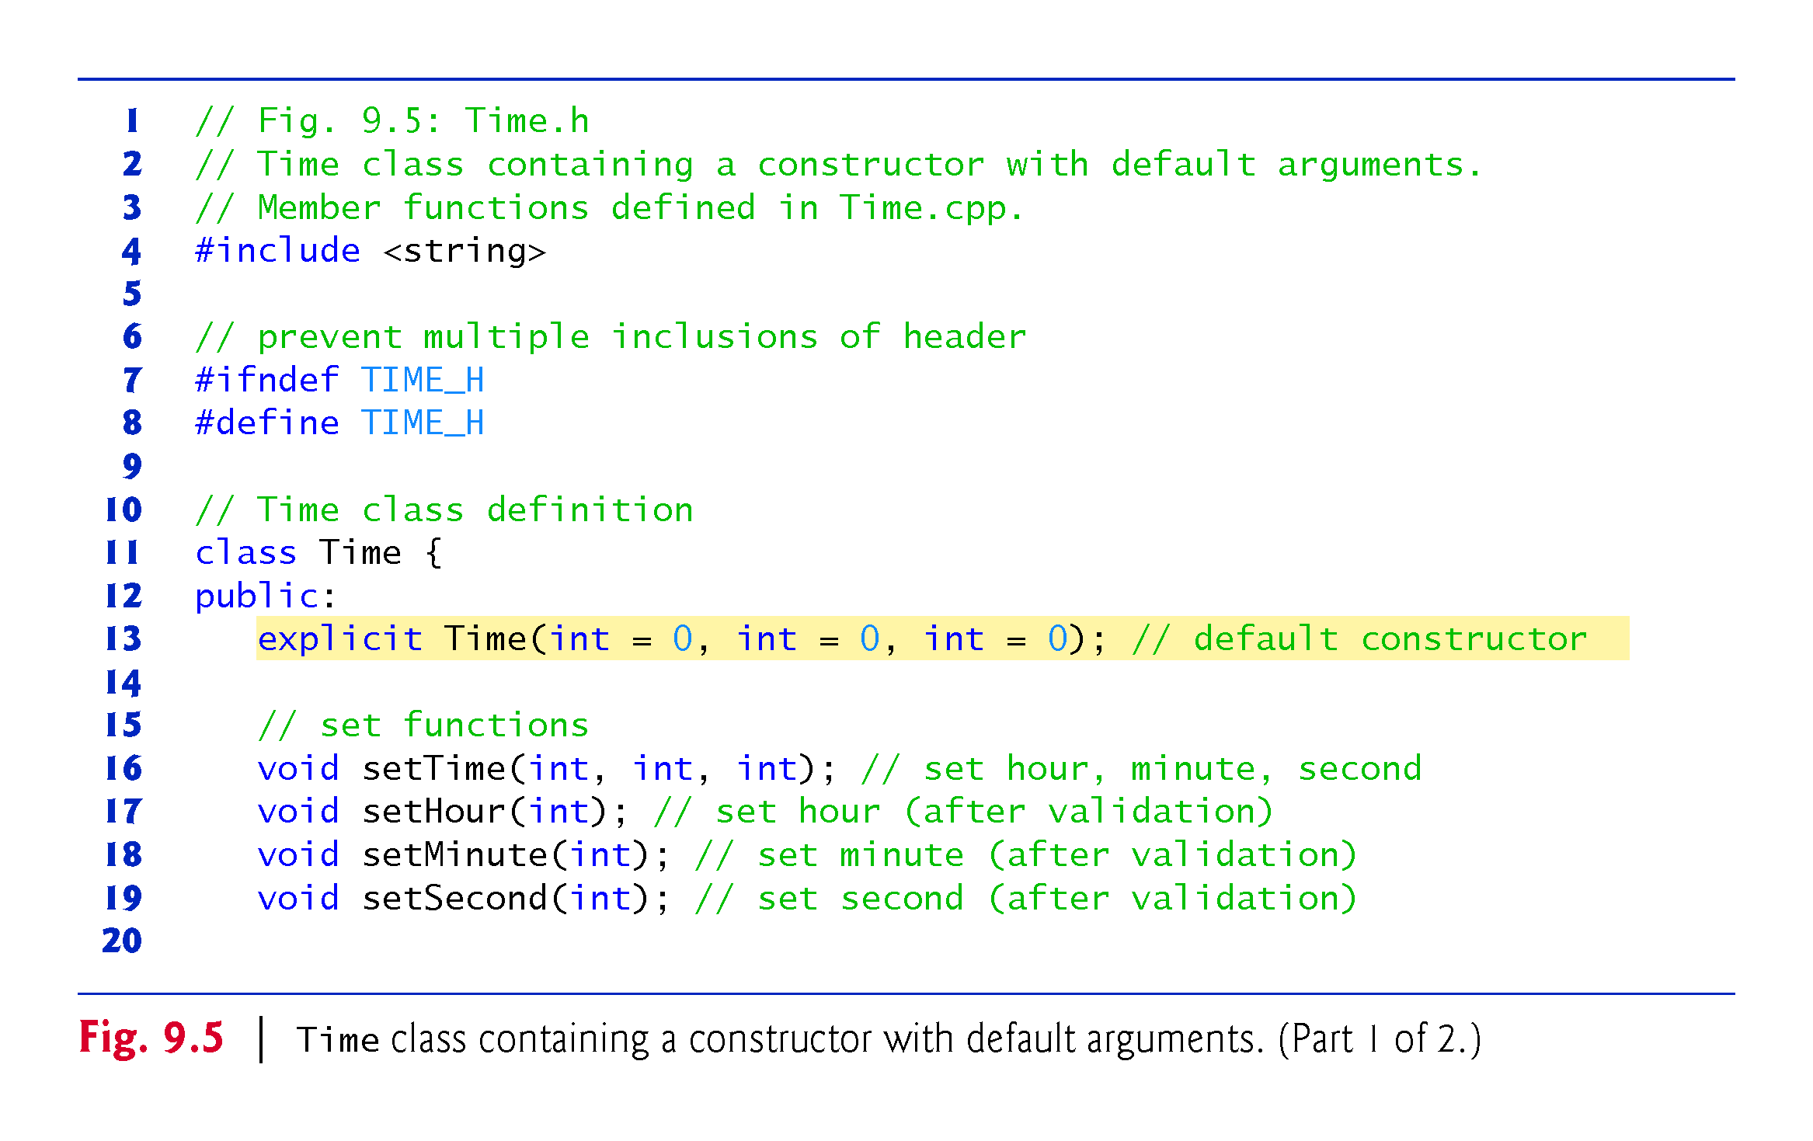

Slide 23
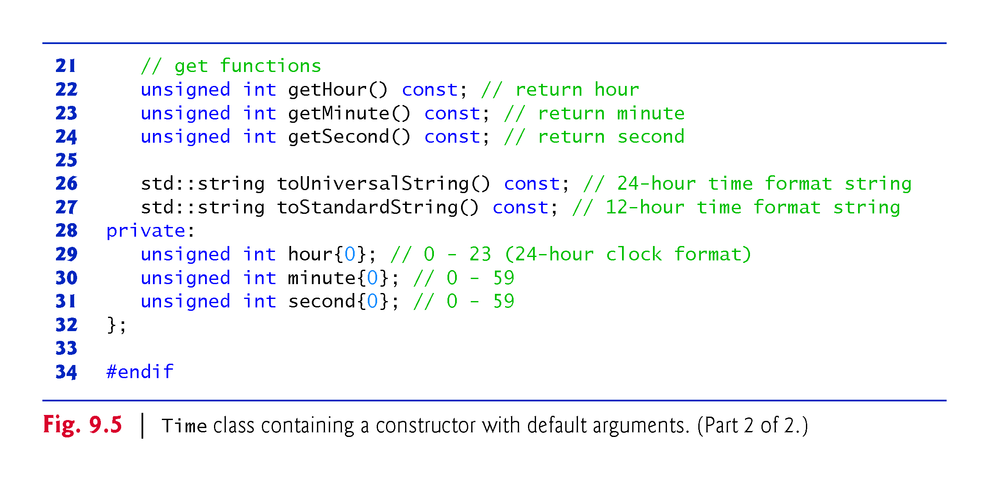

Slide 24
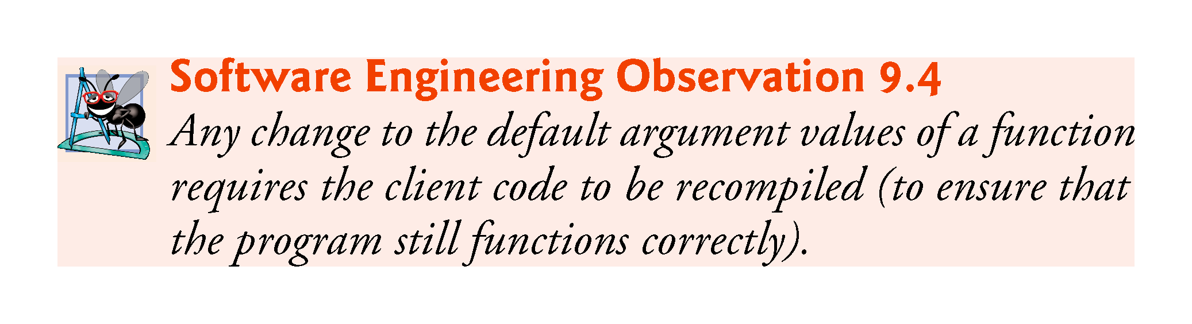

Slide 25
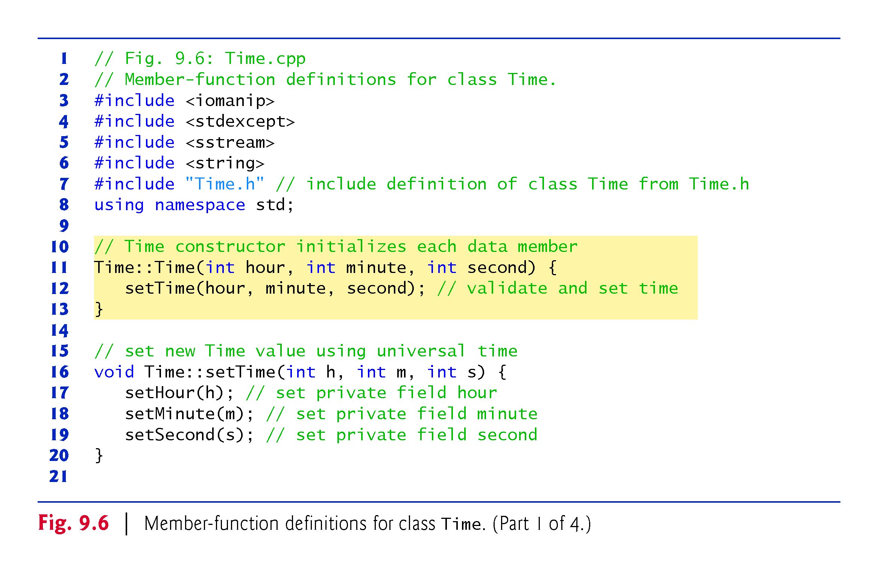
Notes:
Ob: <sstream> is needed for ostringstream class objects and functions

Slide 26
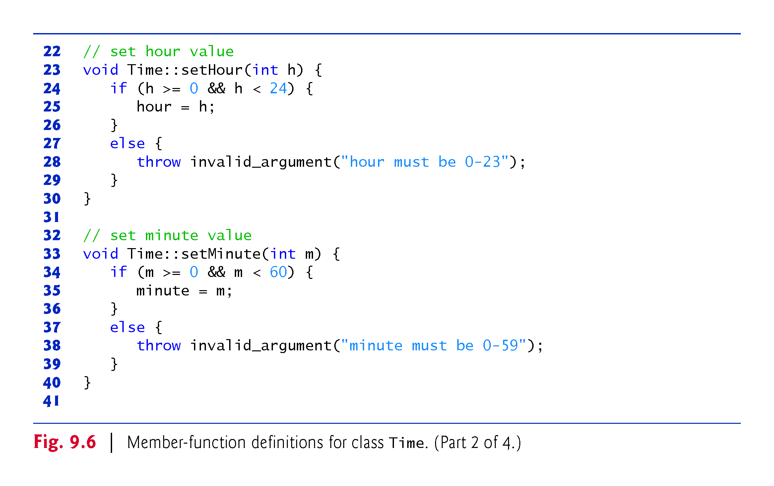

Slide 27
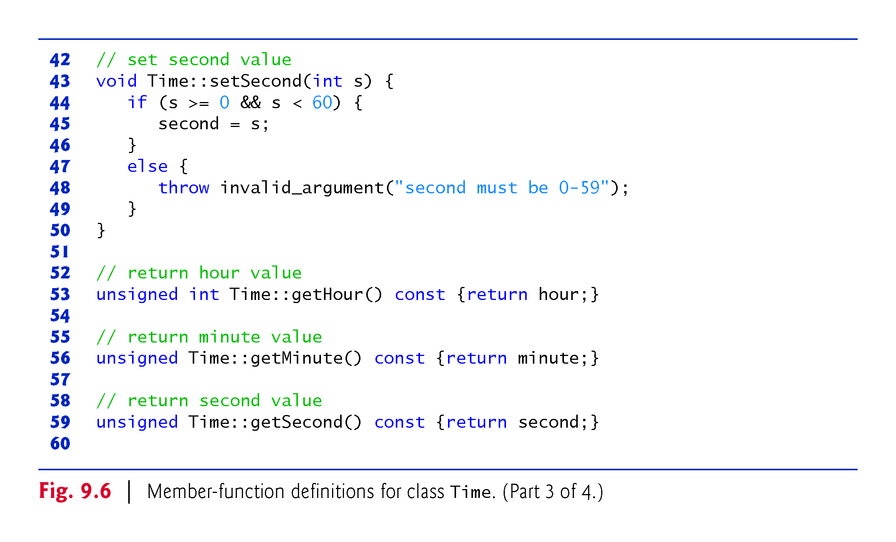
Notes:
Ob: 2 mistakes here – both getminute() and getsecond() should return integers

Slide 28
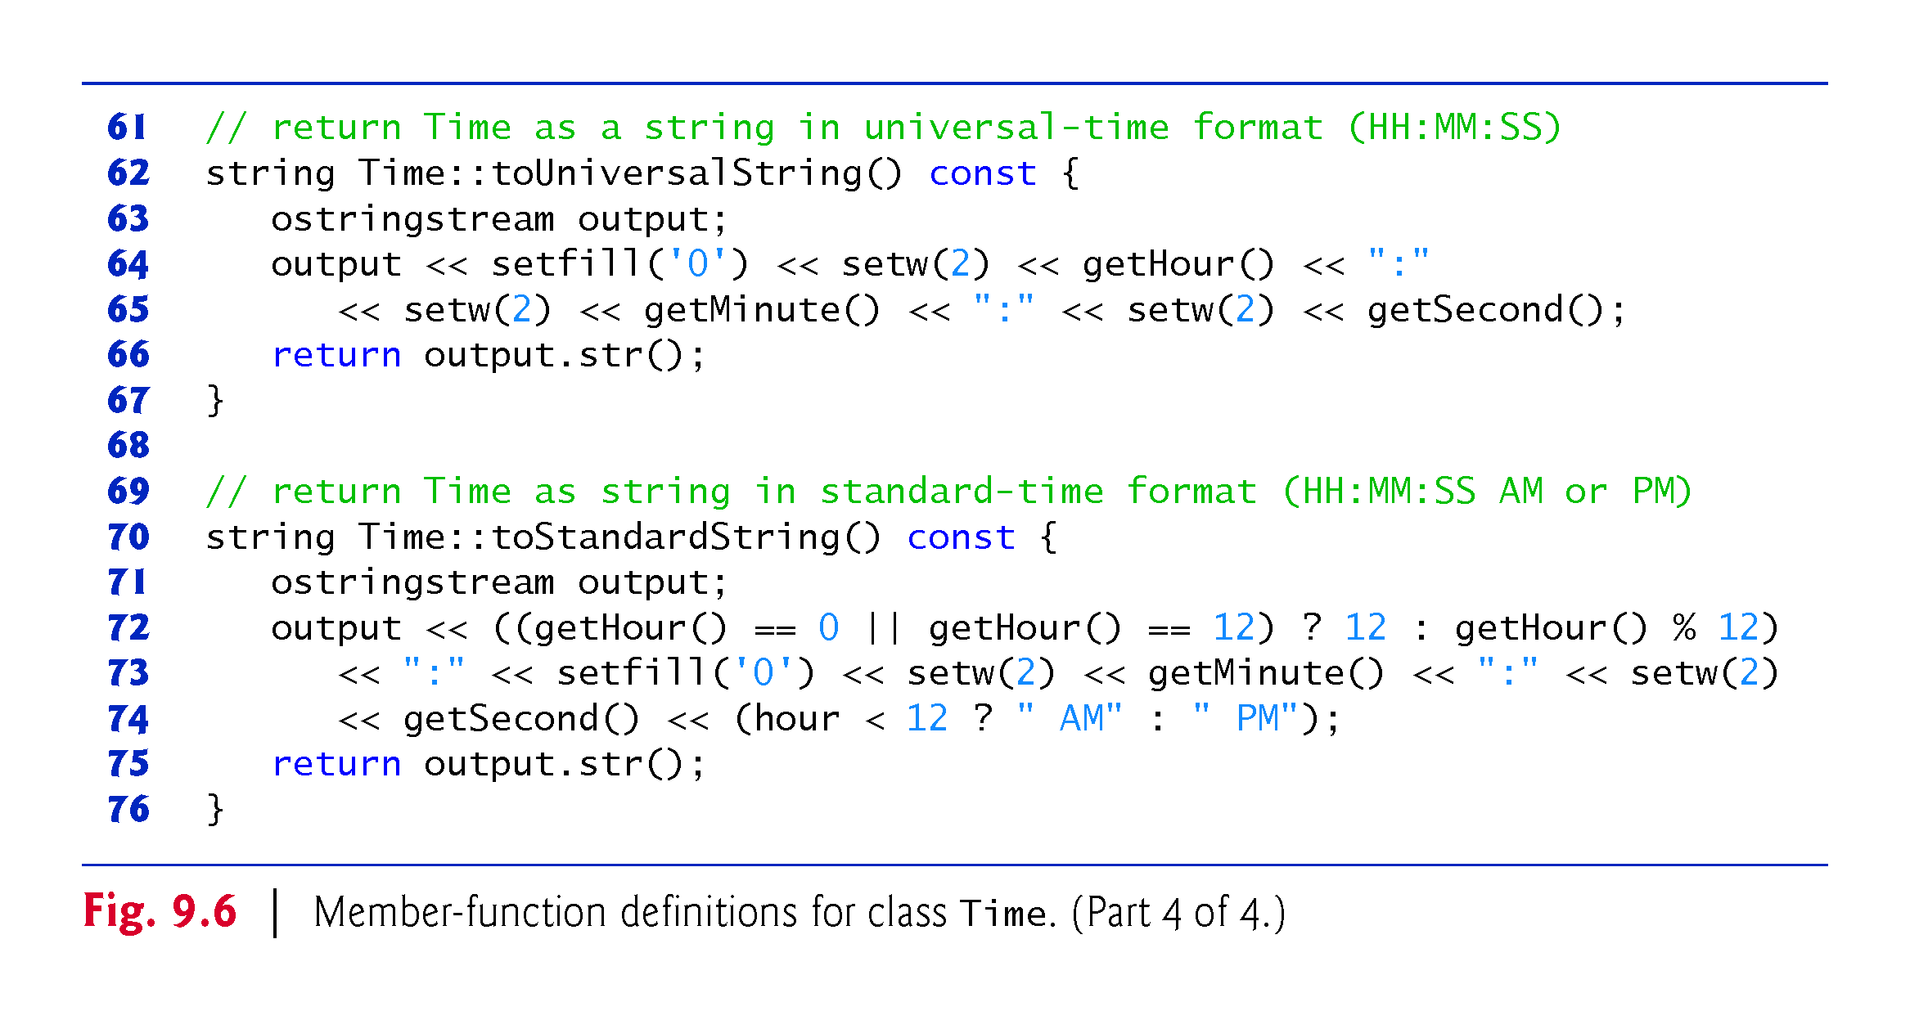

Slide 29
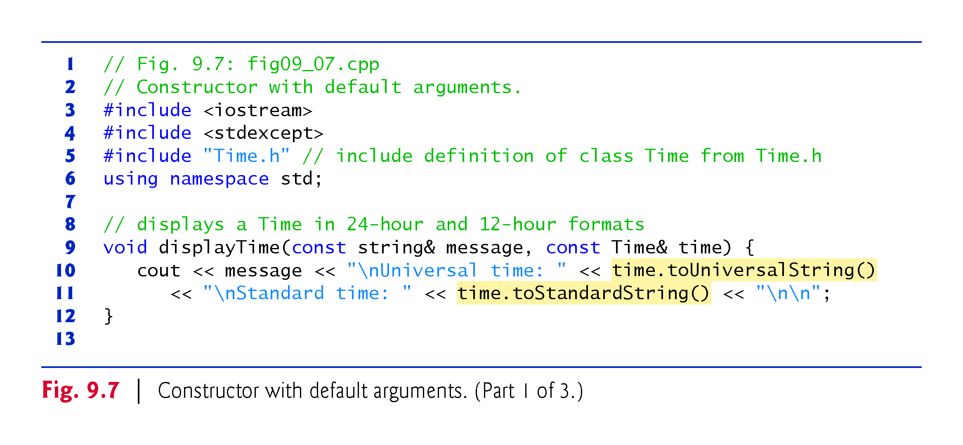

Slide 30
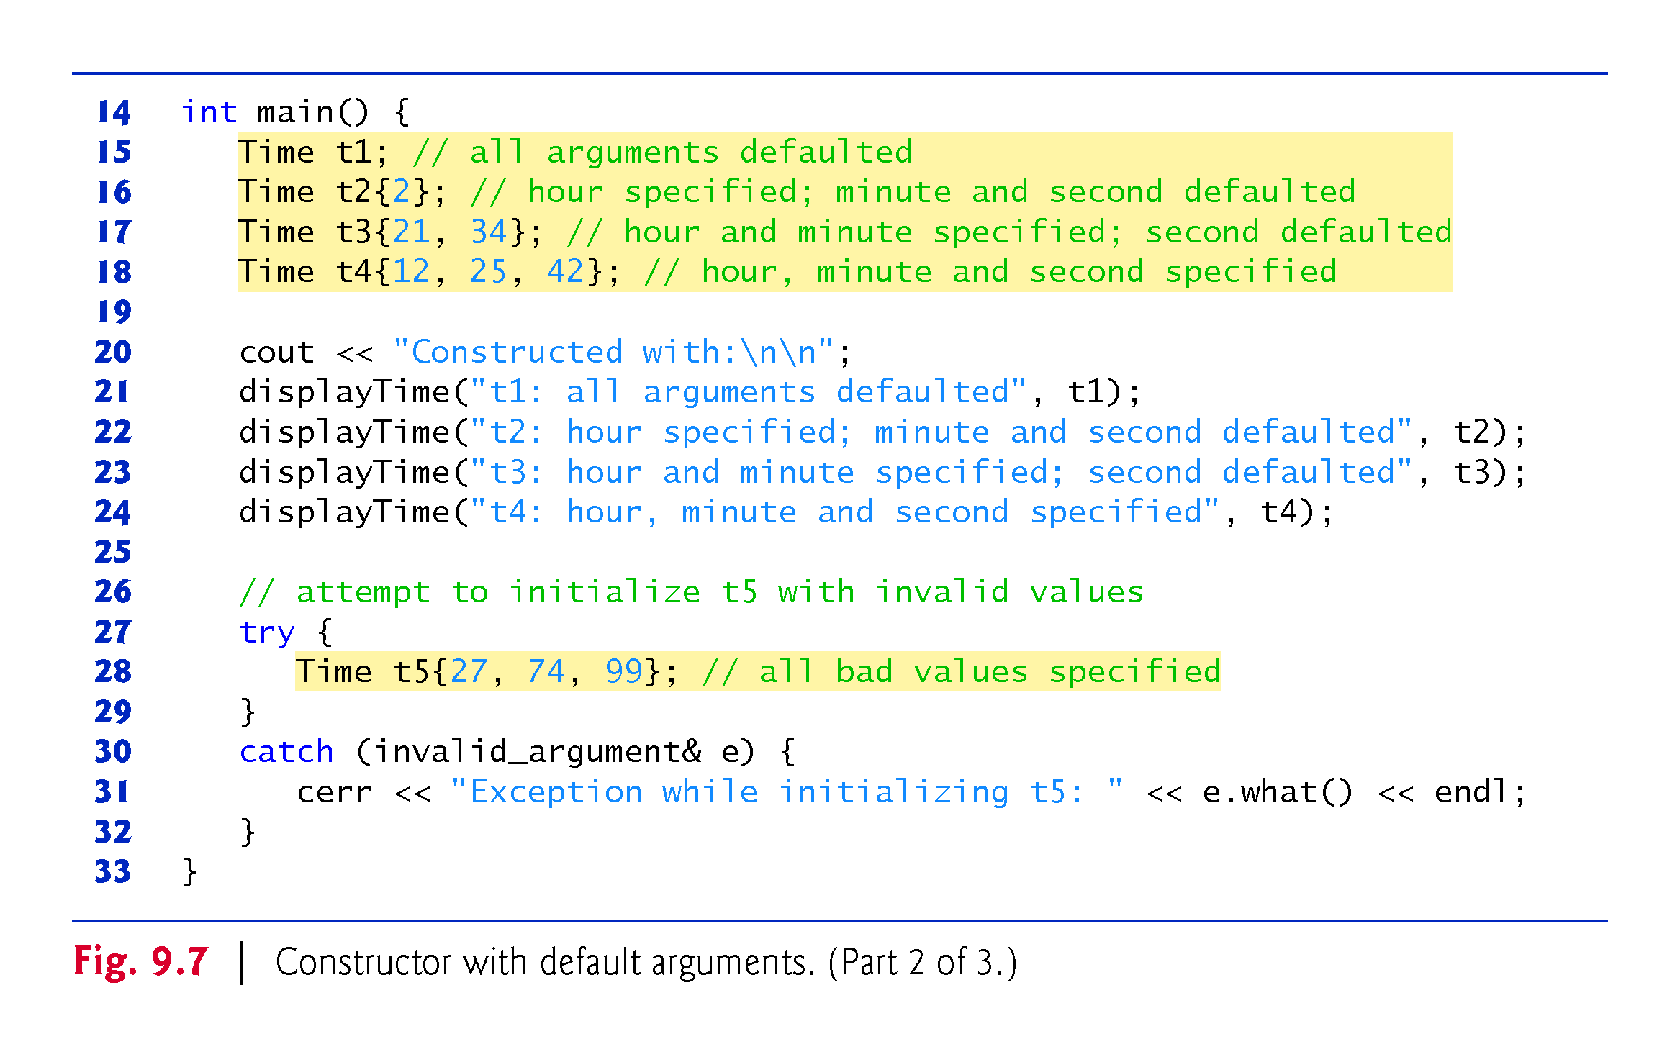

Slide 31
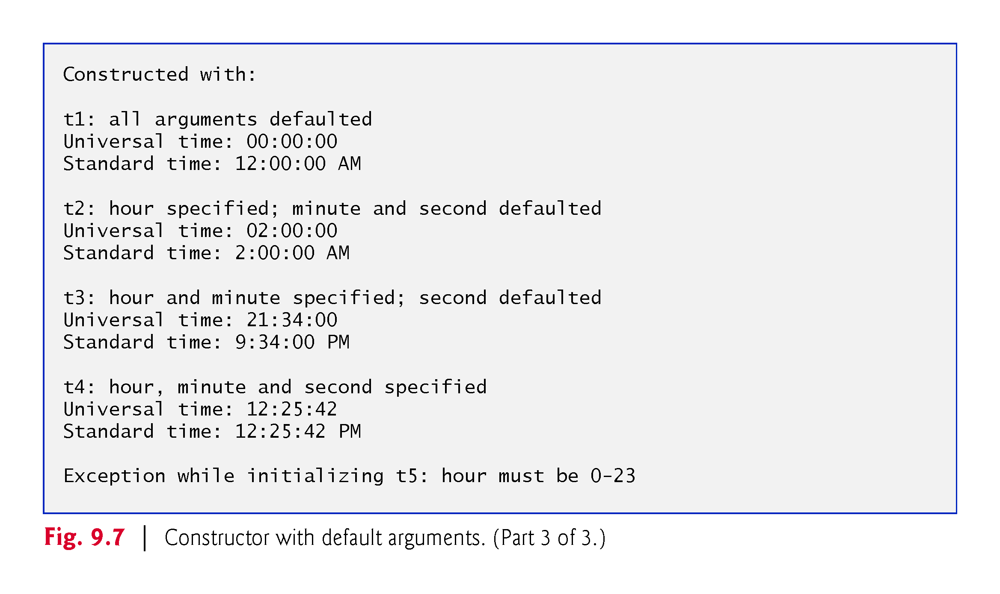

Slide 32
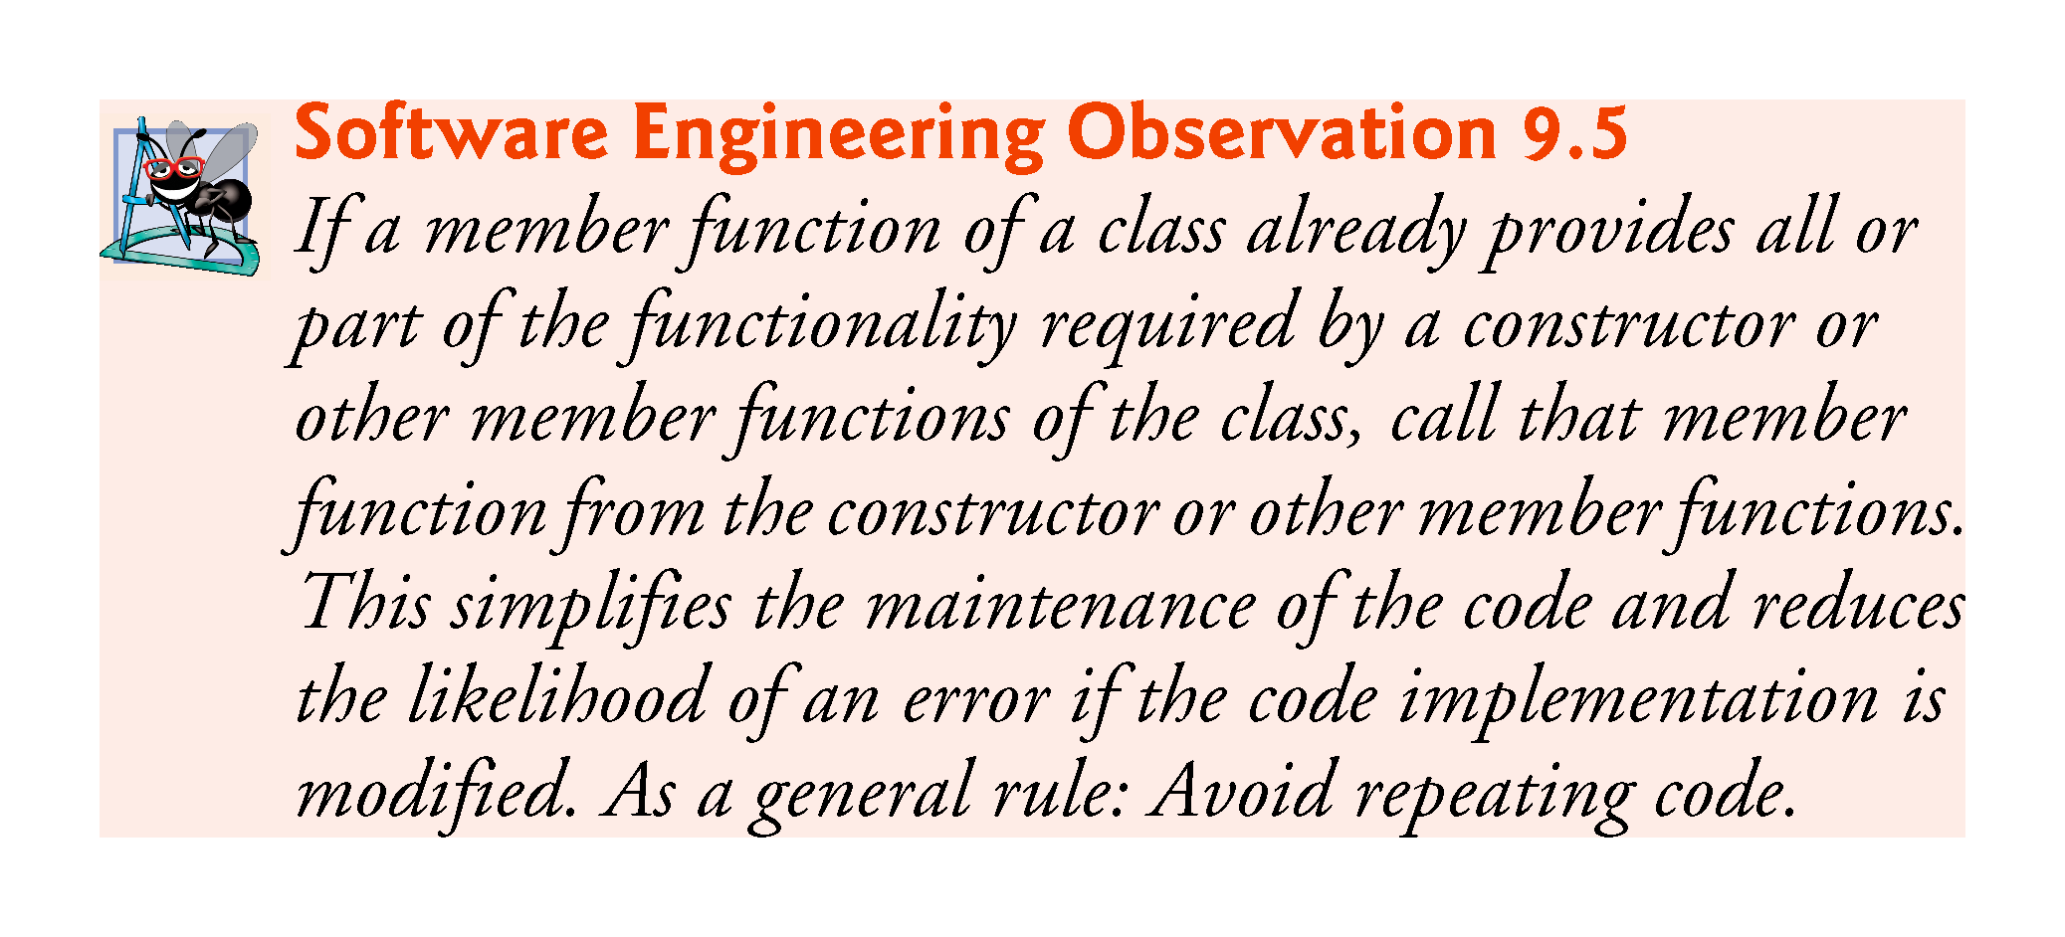

Slide 33
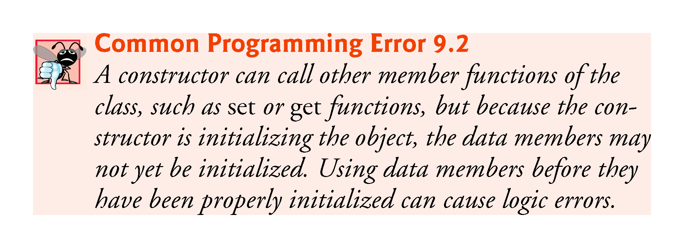

Slide 34


Slide 35
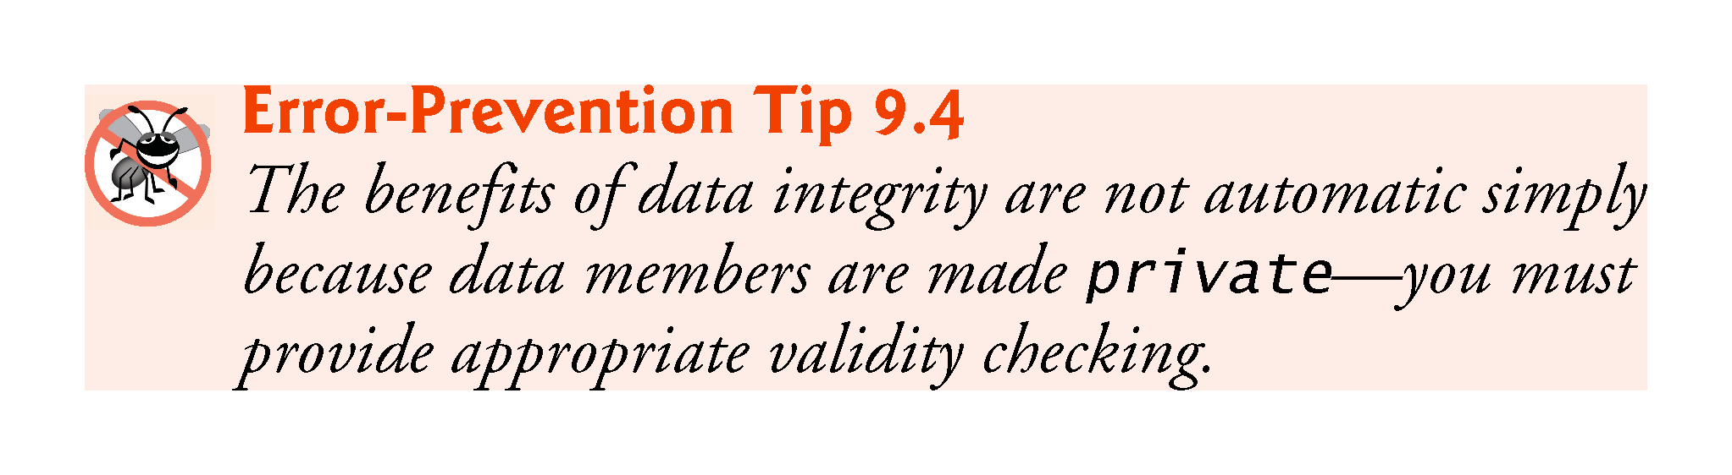

Slide 36
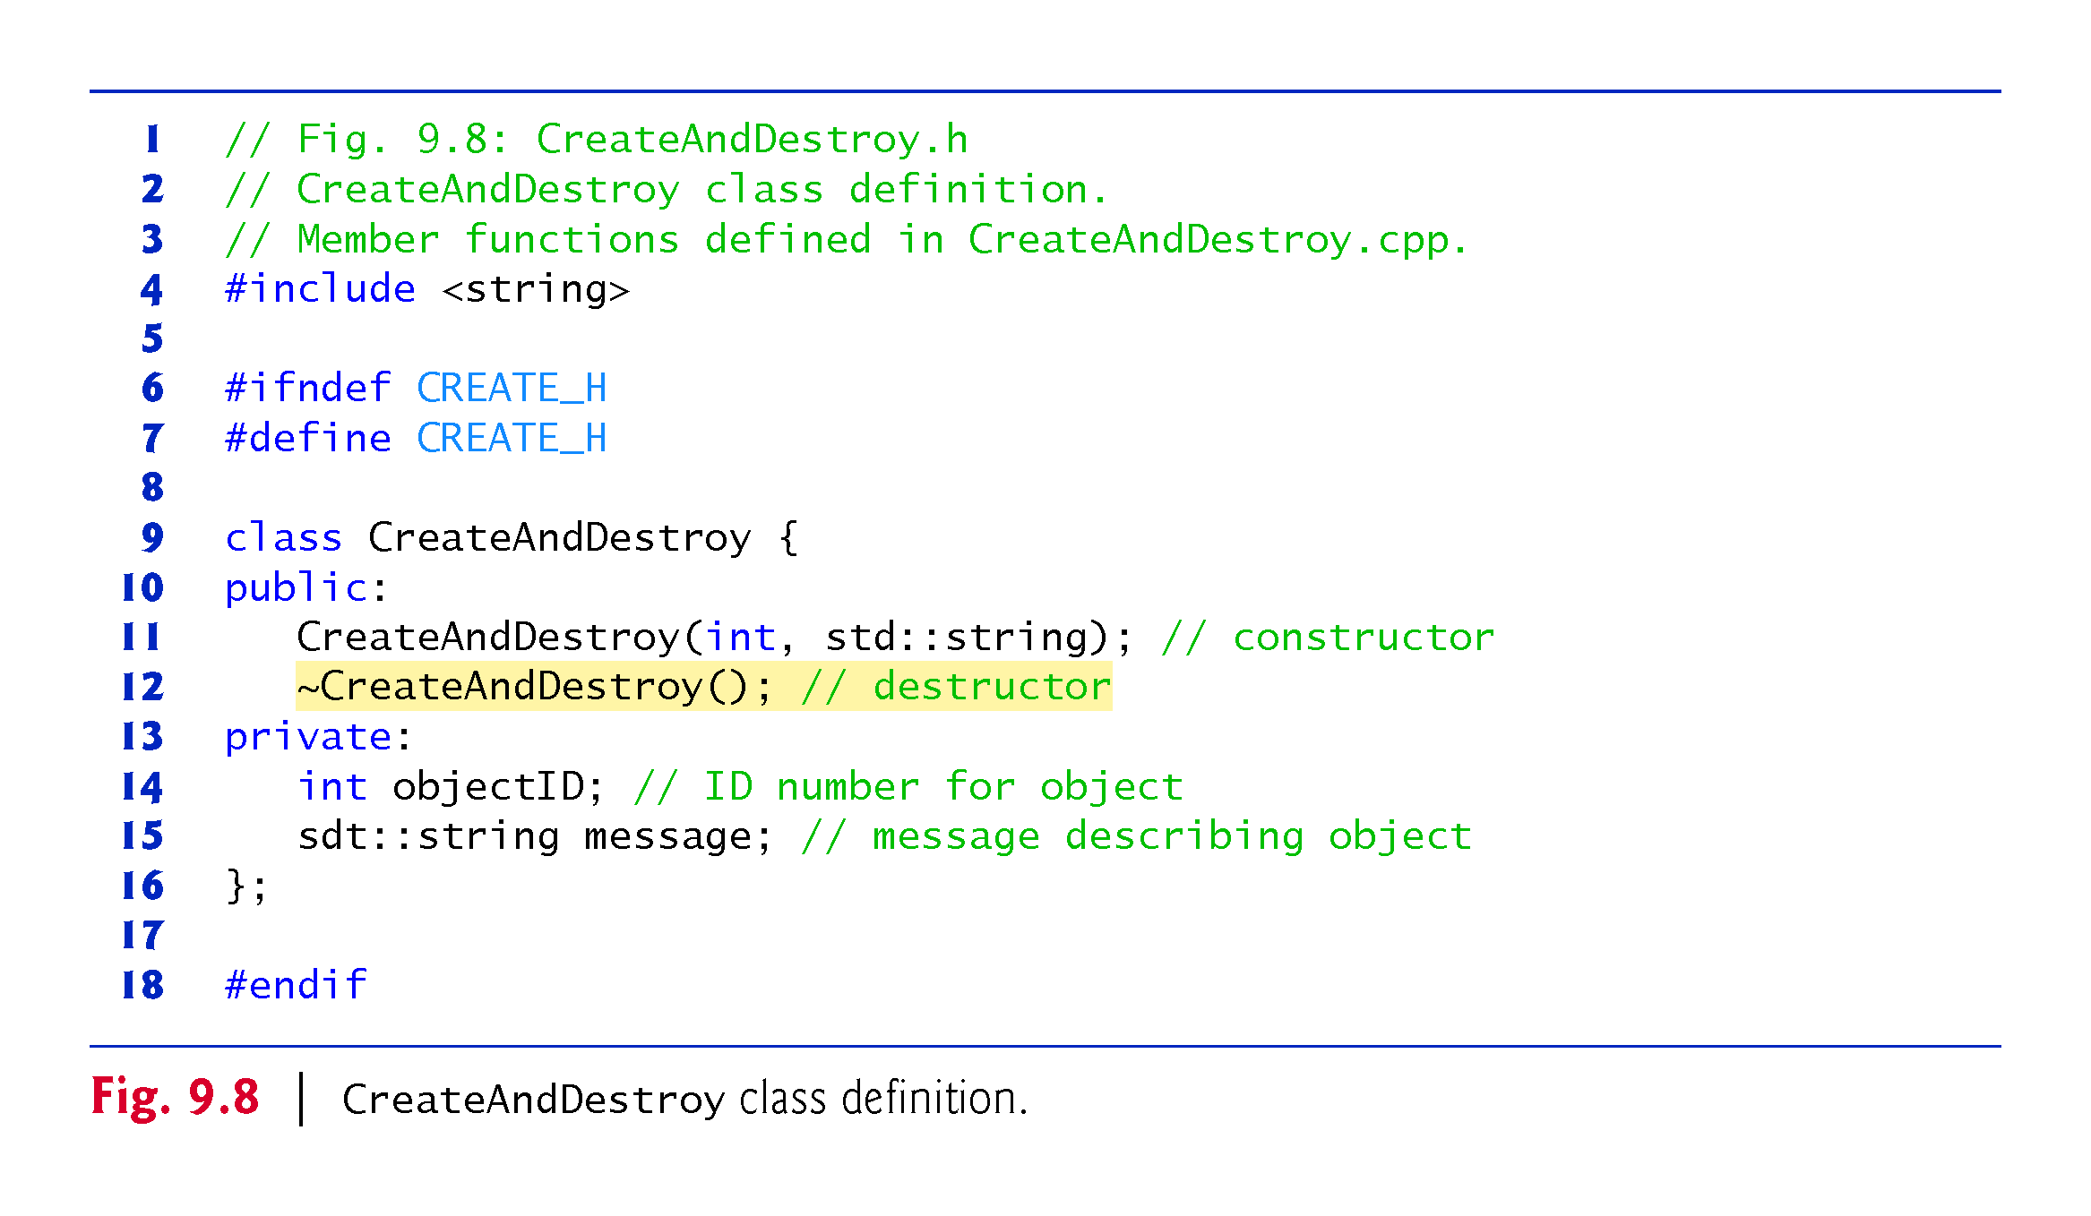
Notes:
Ob: error in message private data member – its should be of type std::string

Slide 37
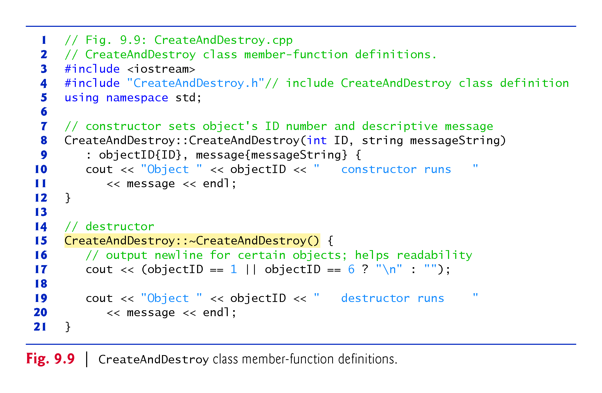

Slide 38
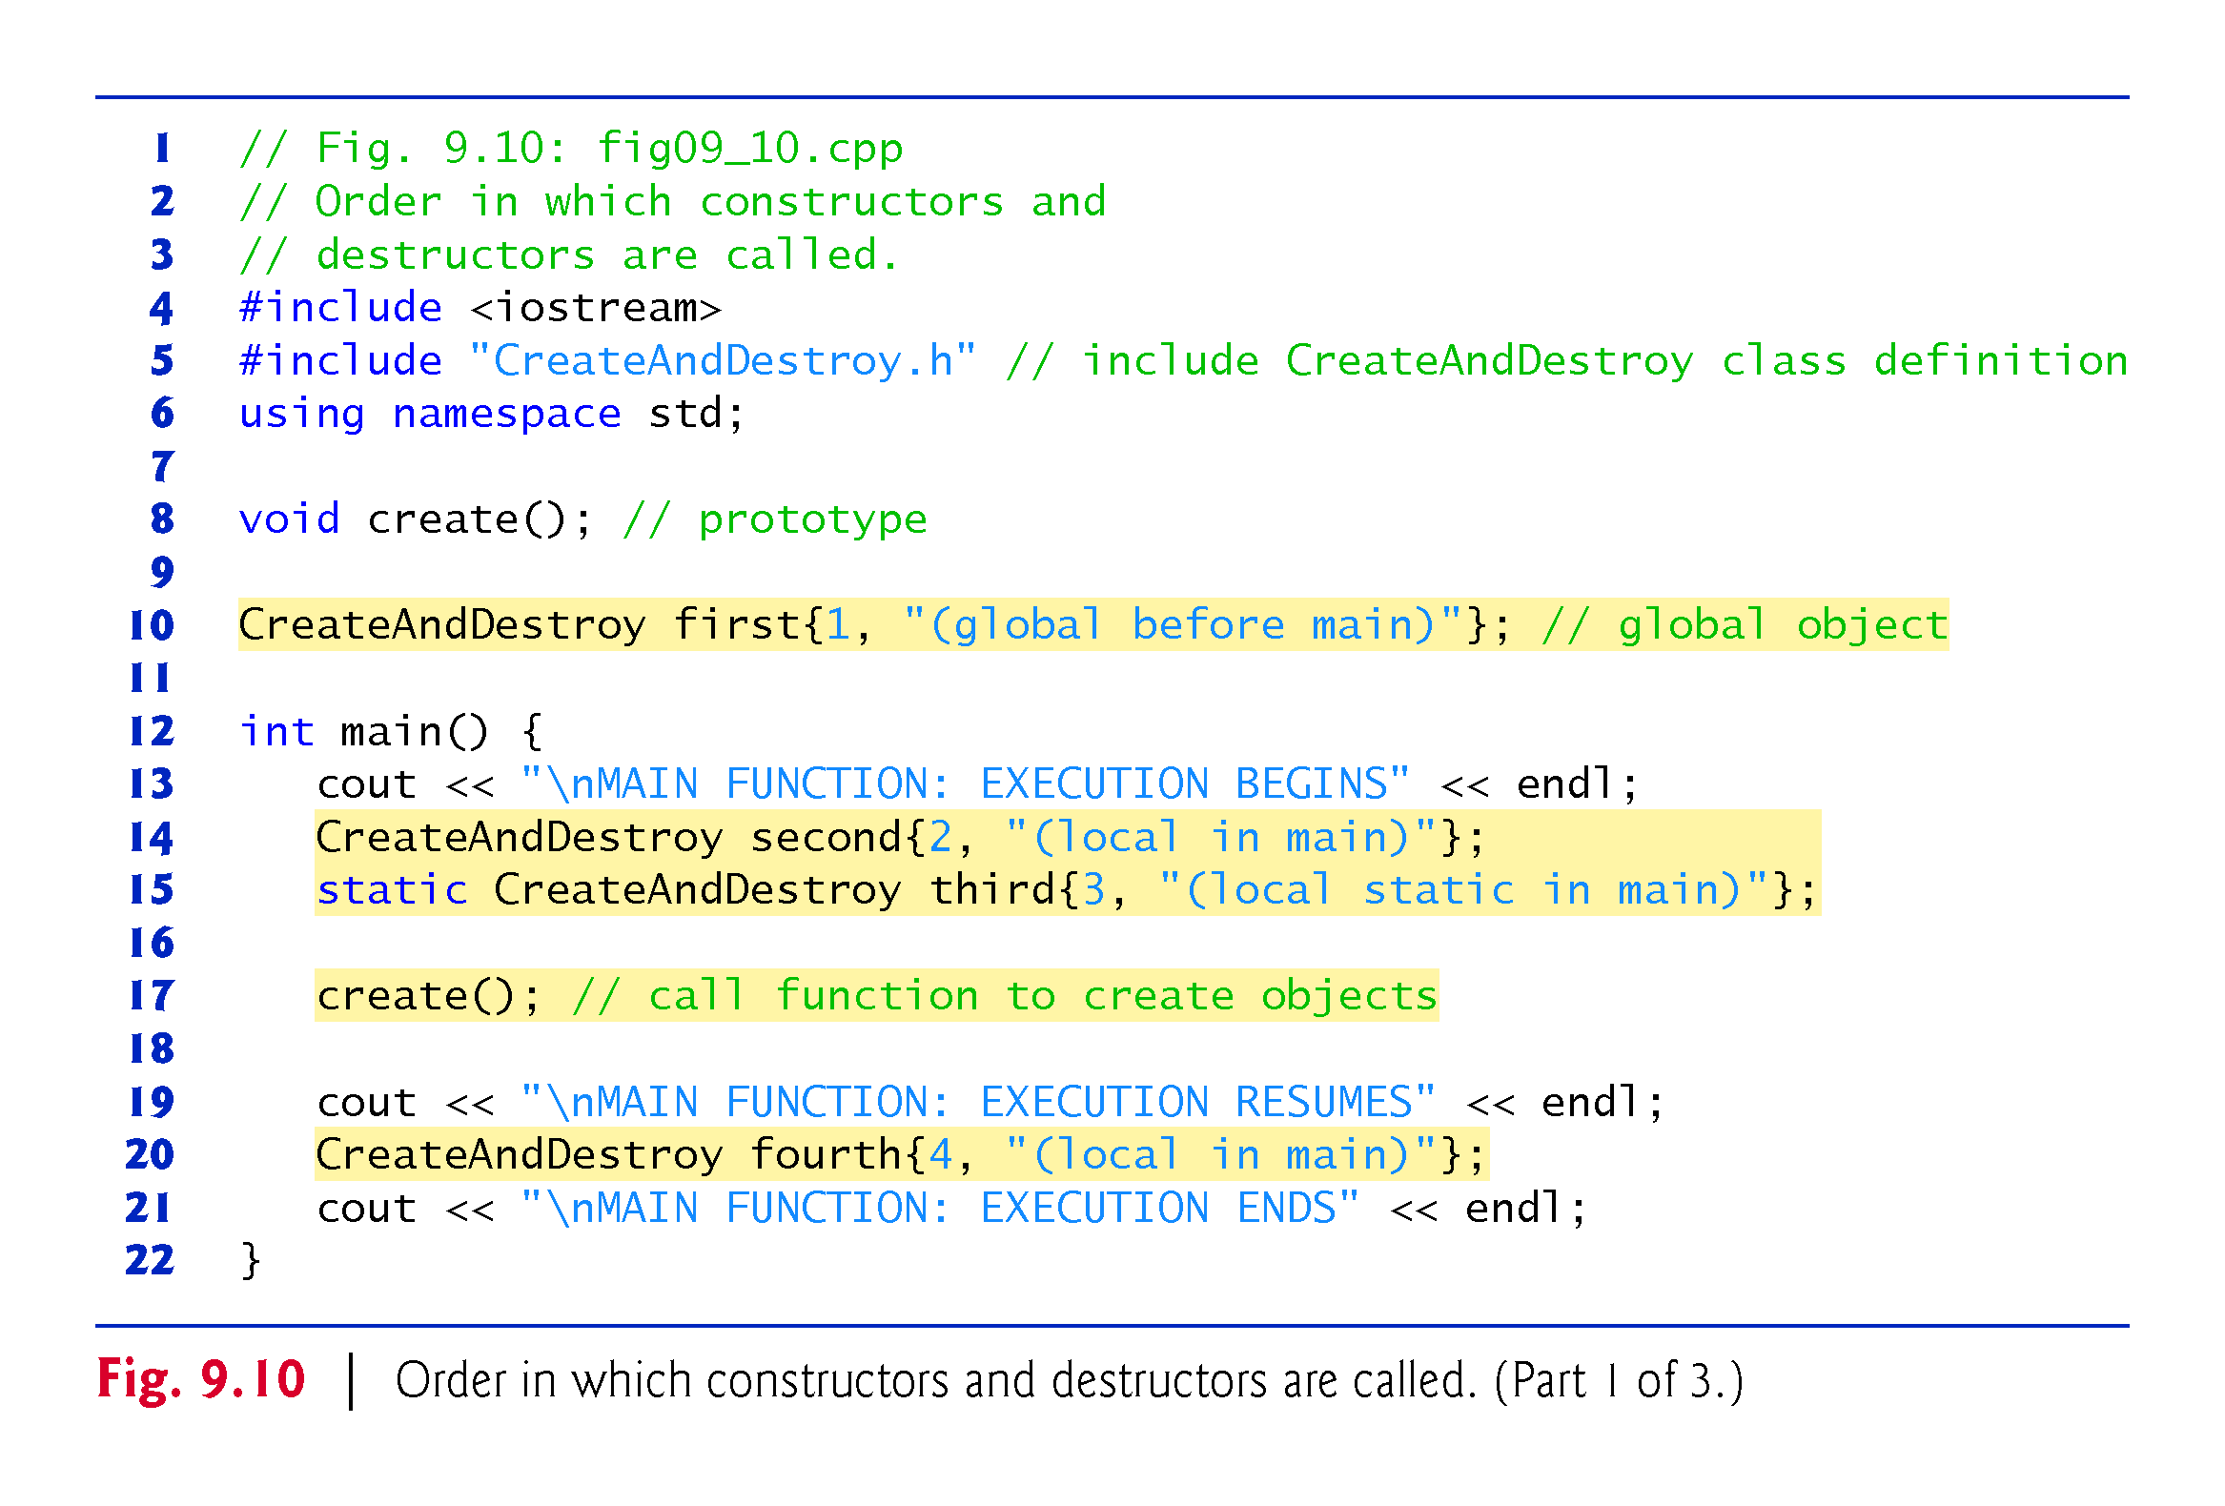

Slide 39
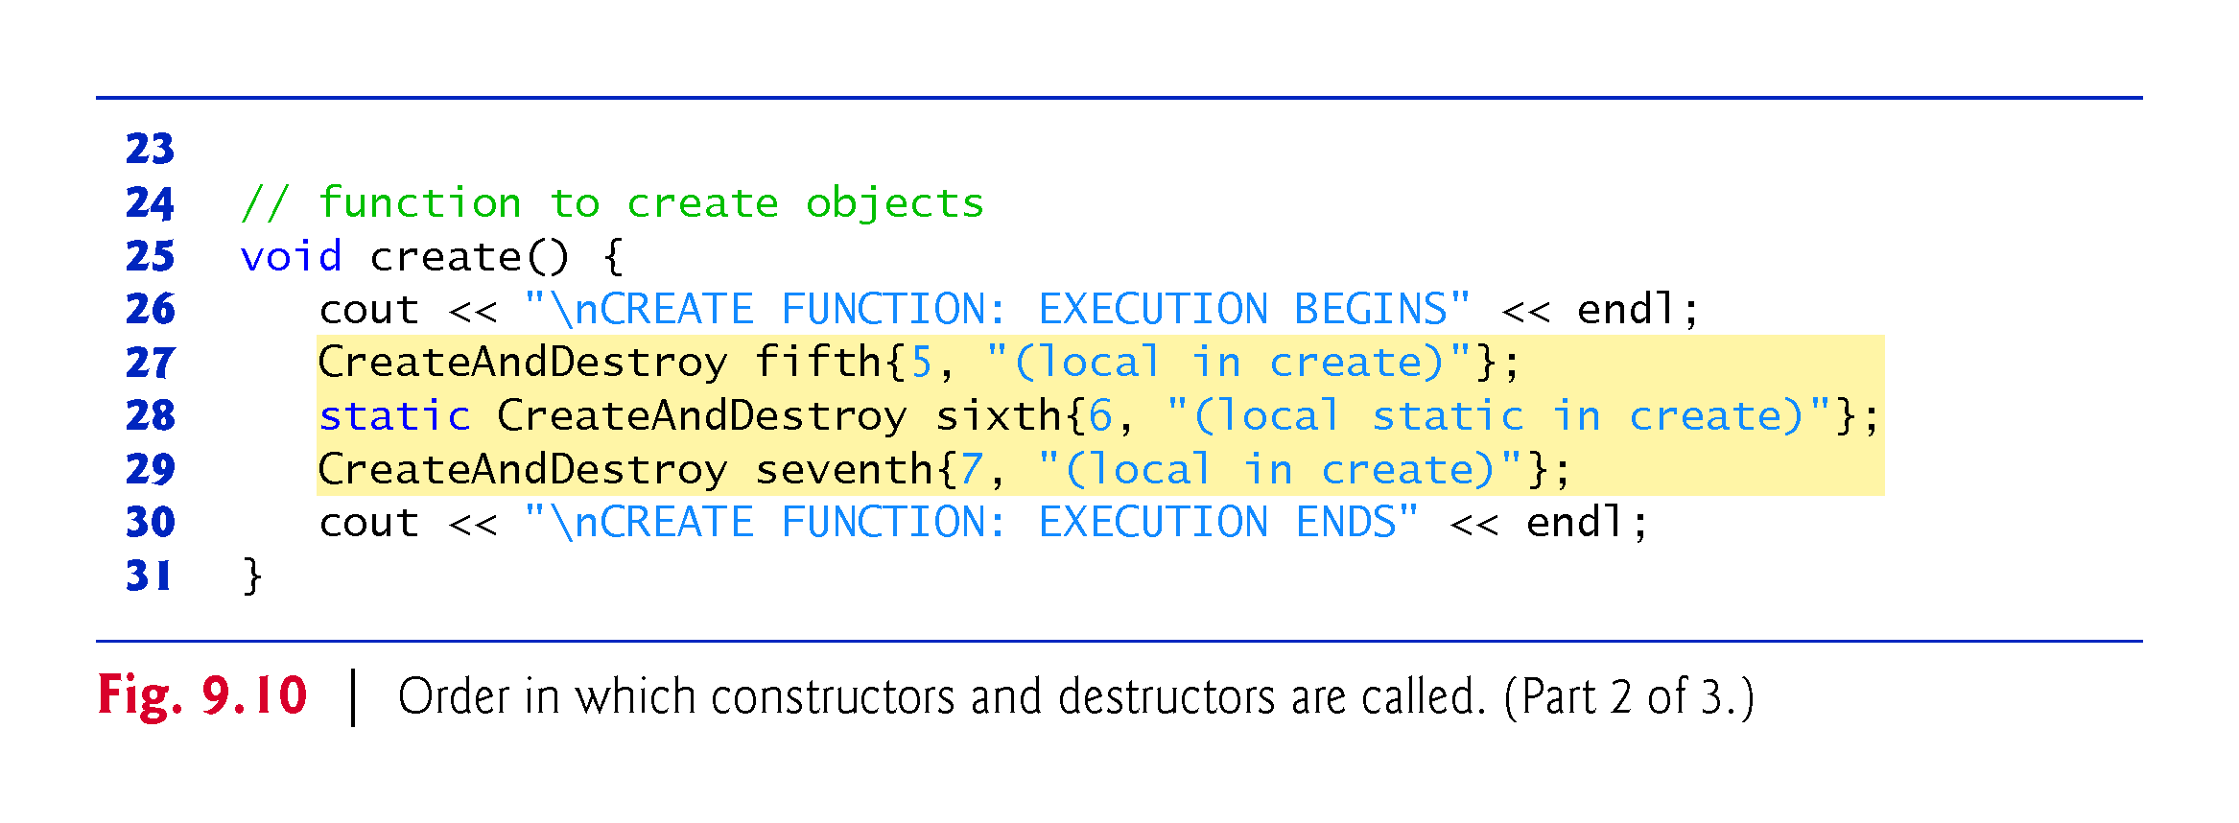

Slide 40
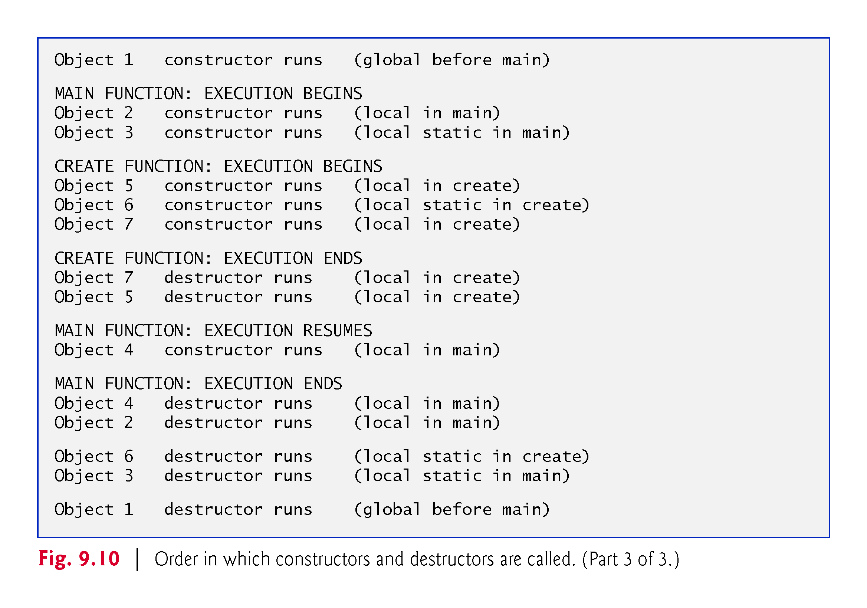

Slide 41
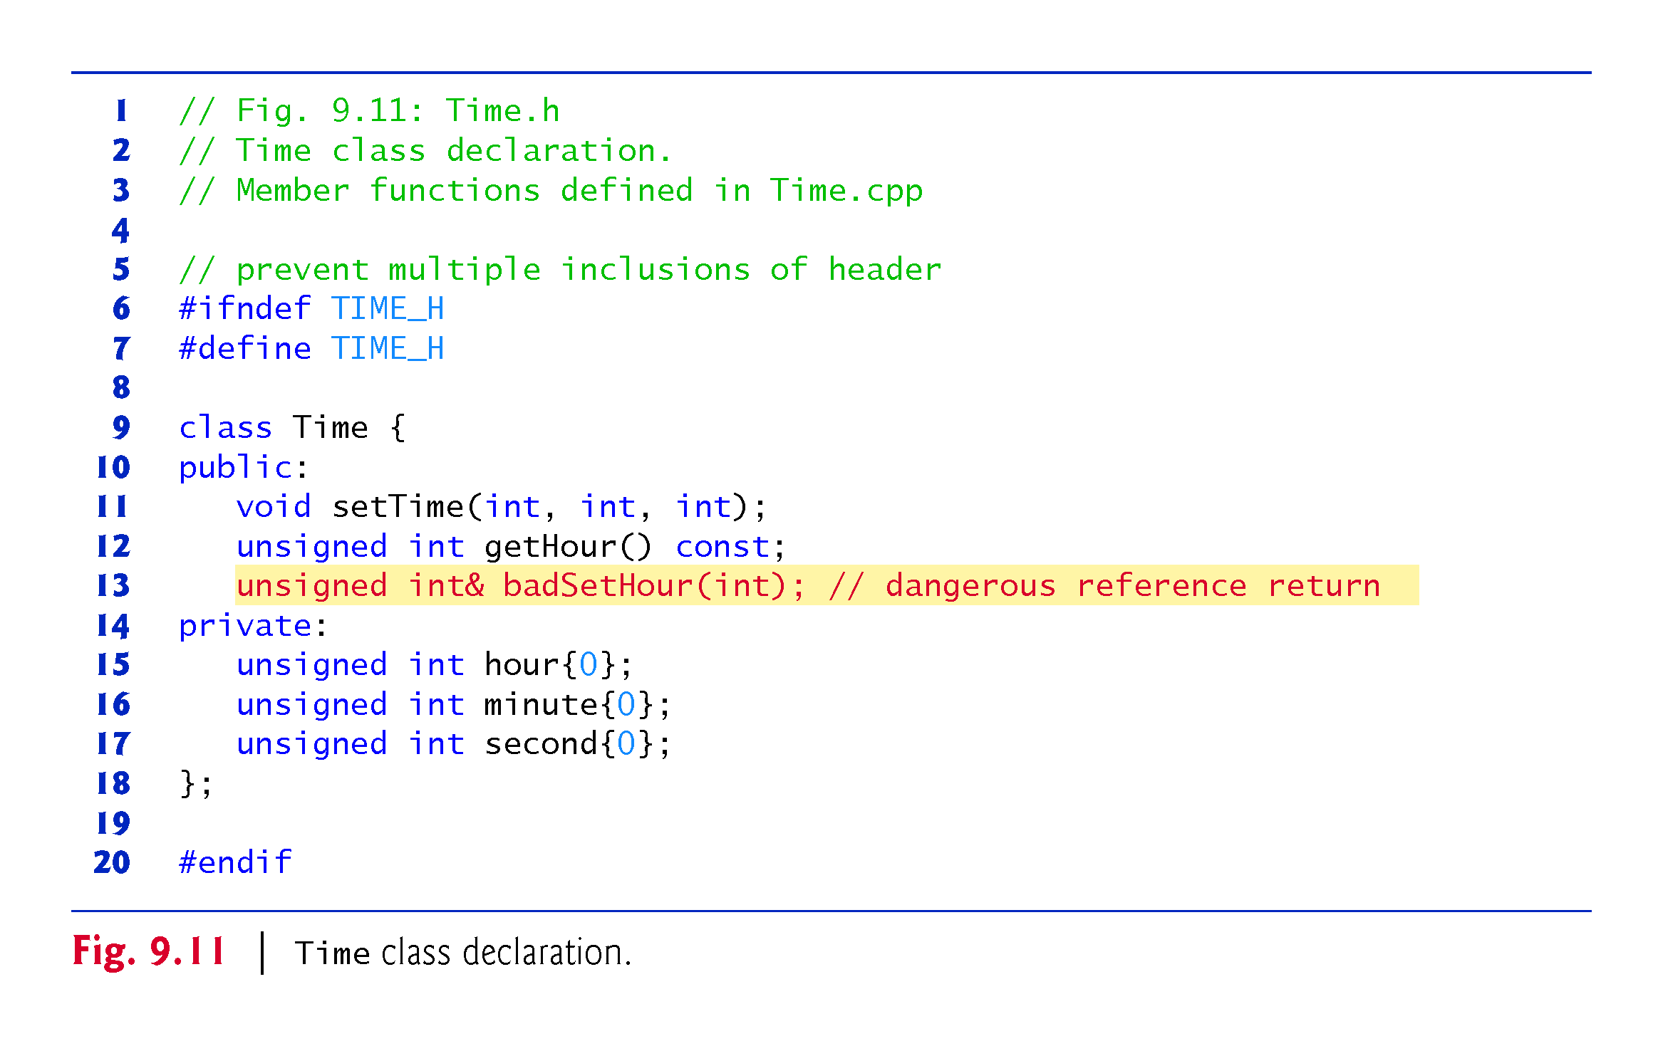

Slide 42
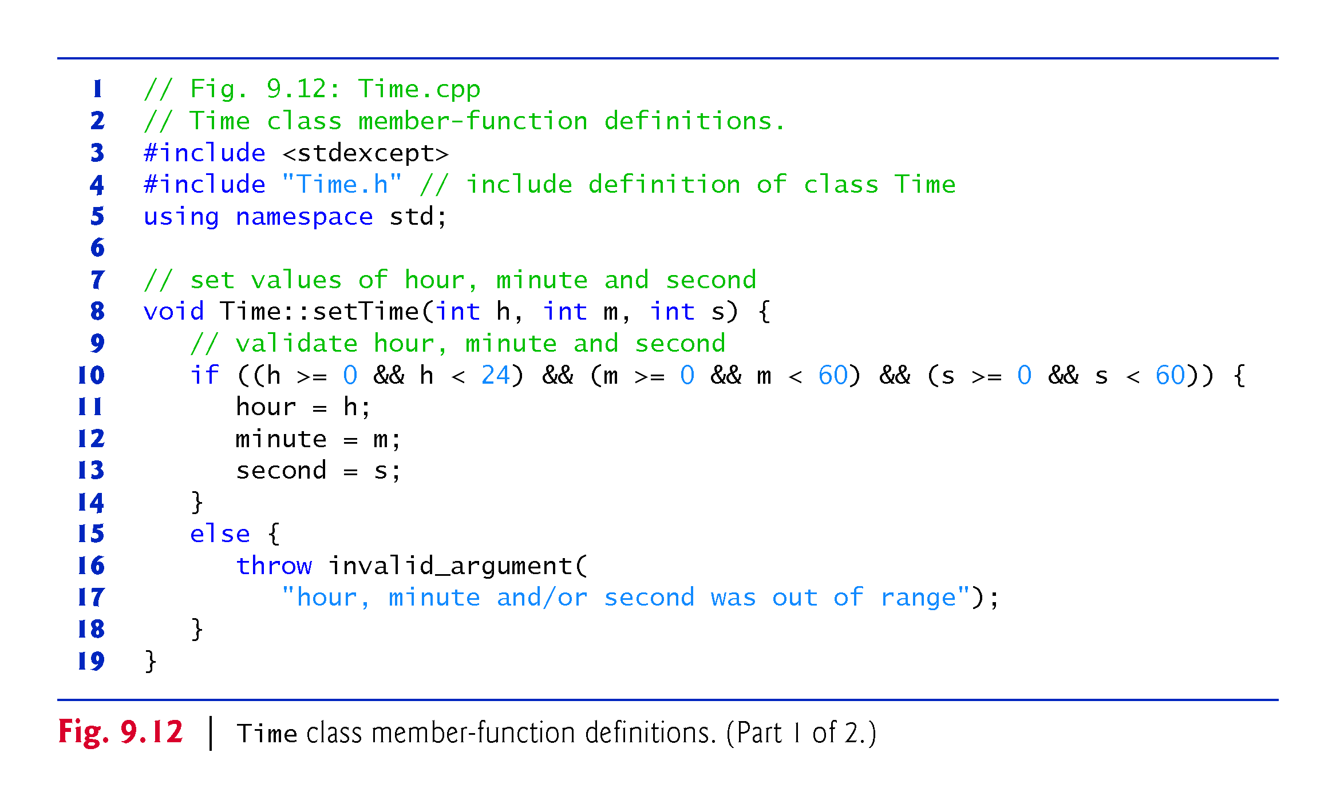

Slide 43
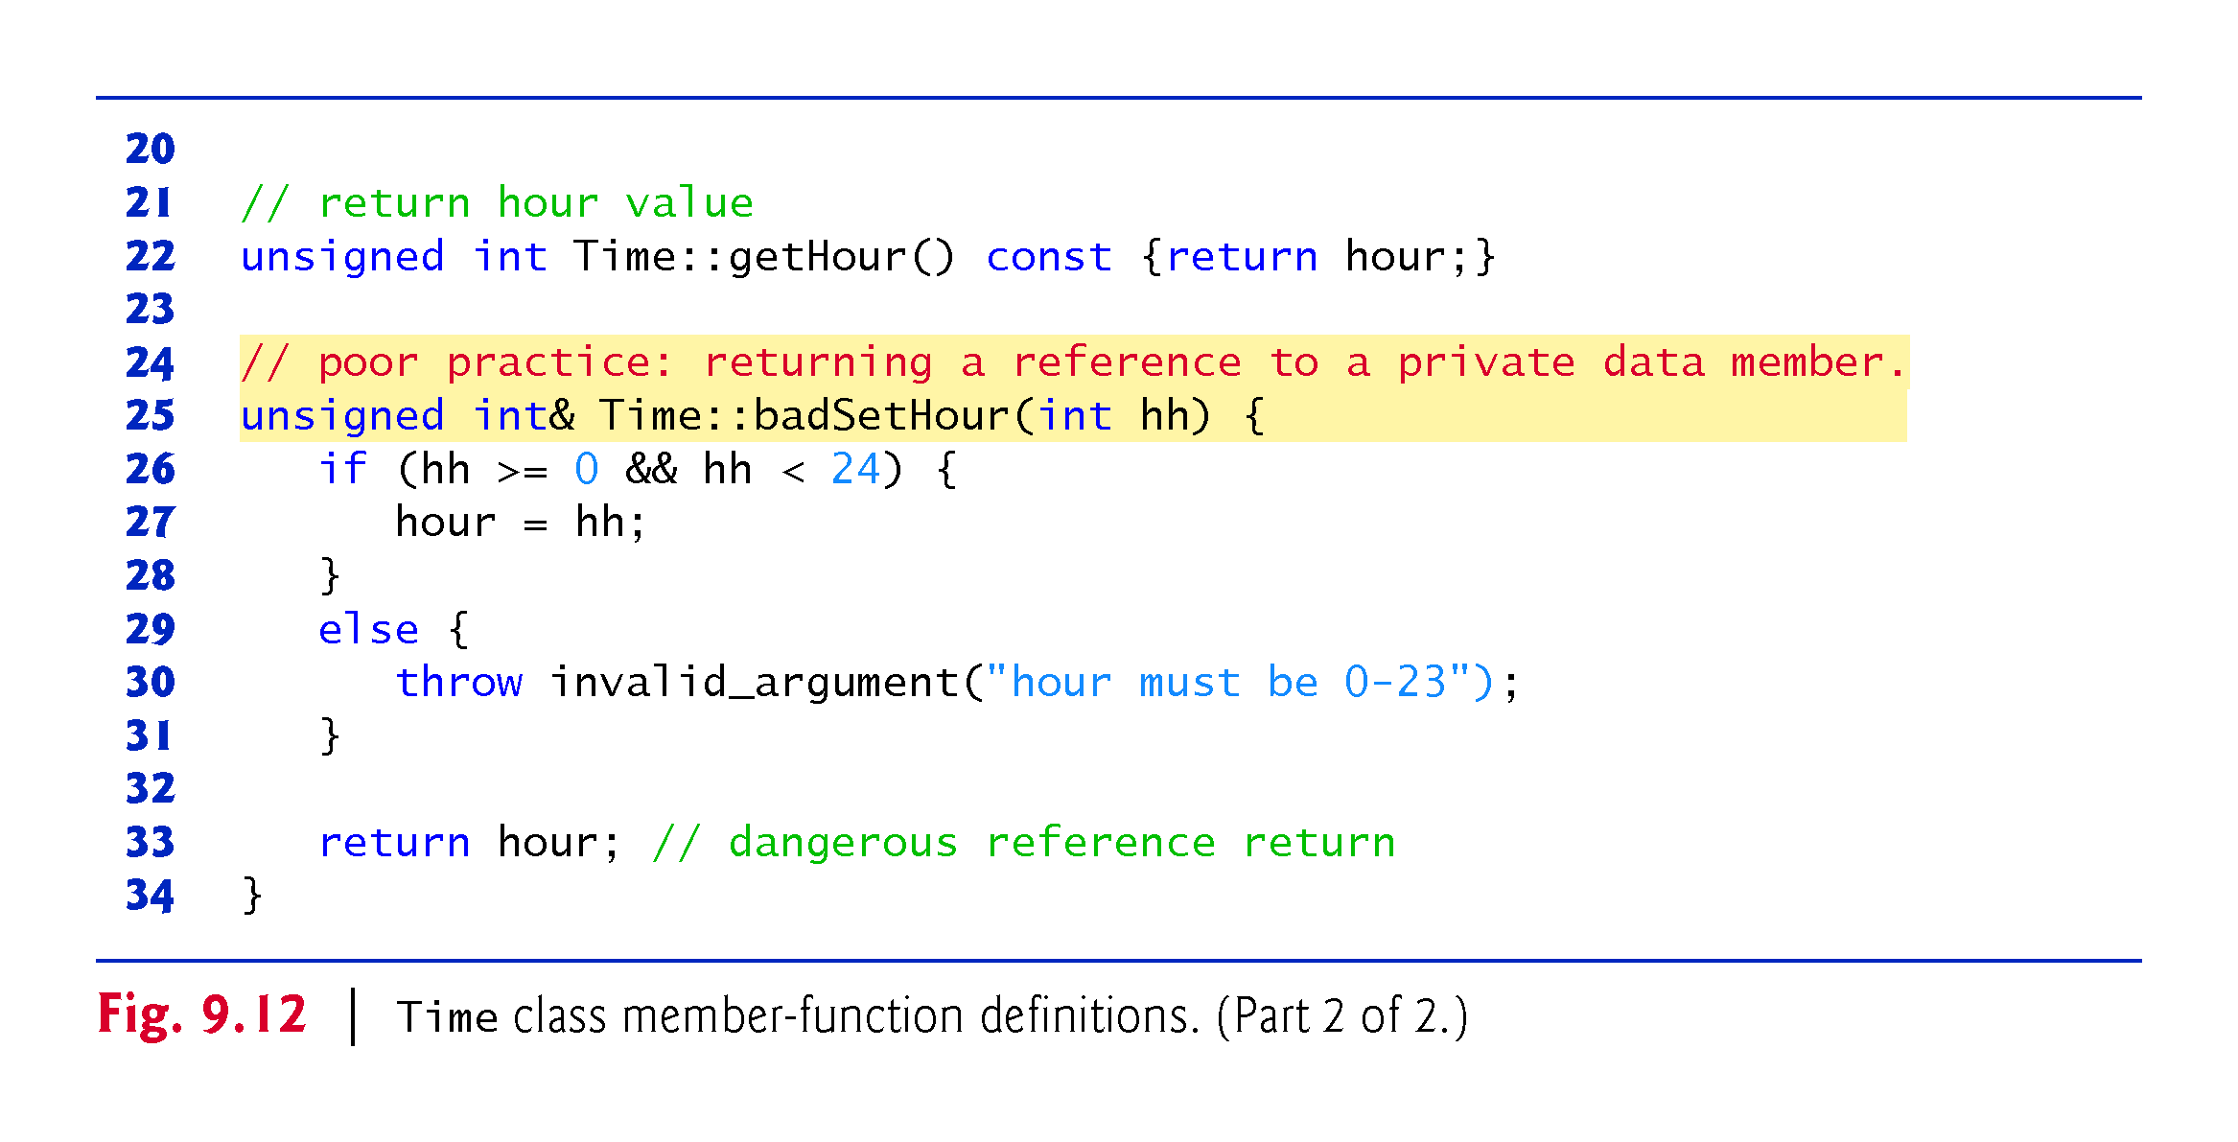

Slide 44
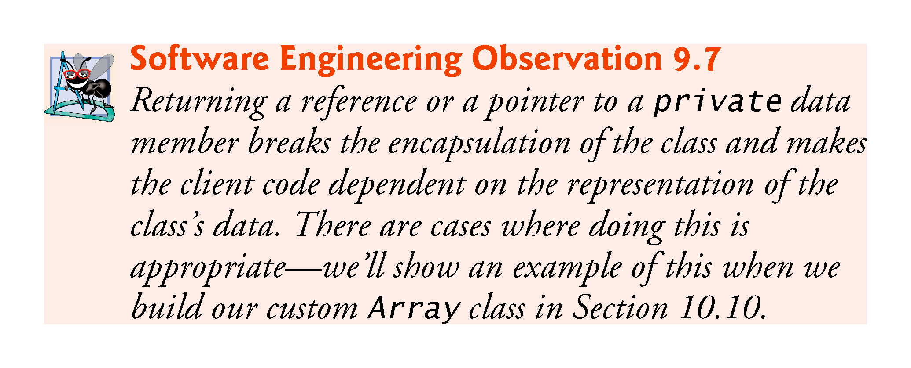

Slide 45
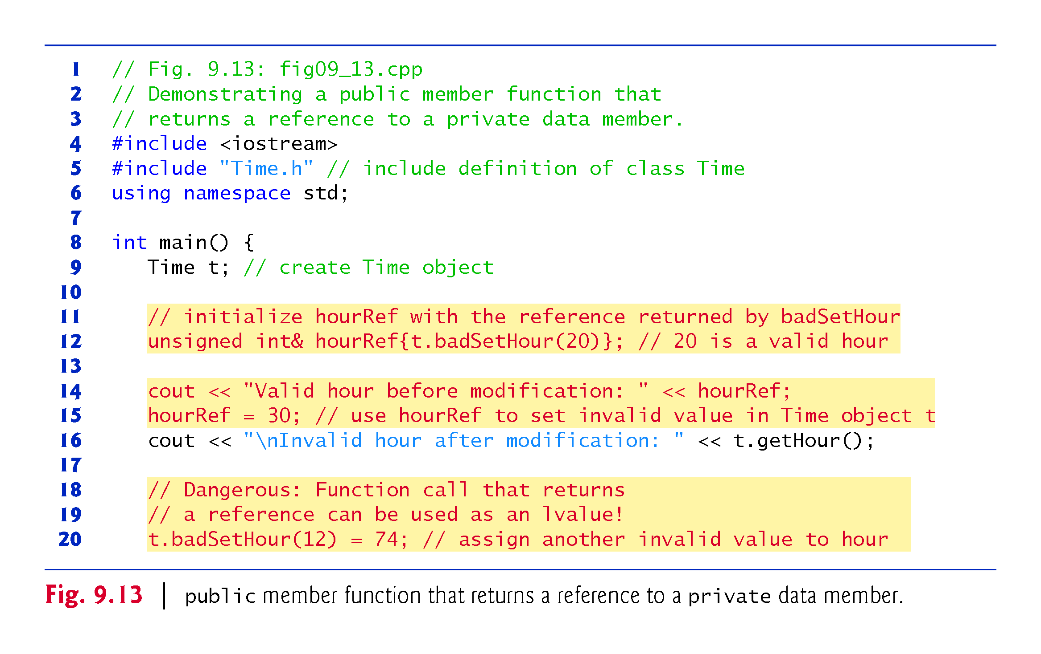

Slide 46
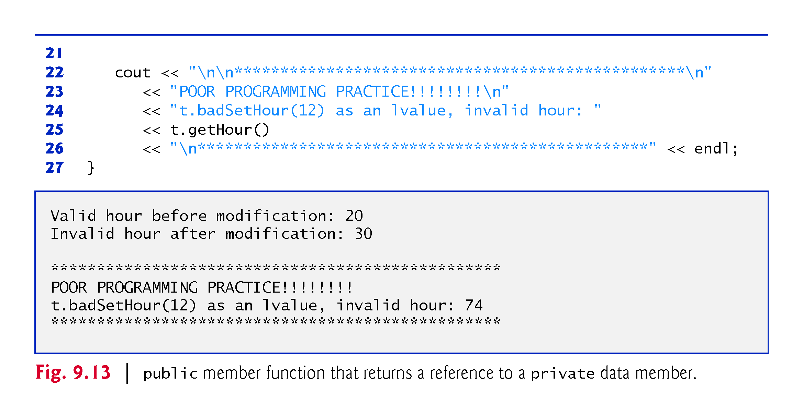

Slide 47
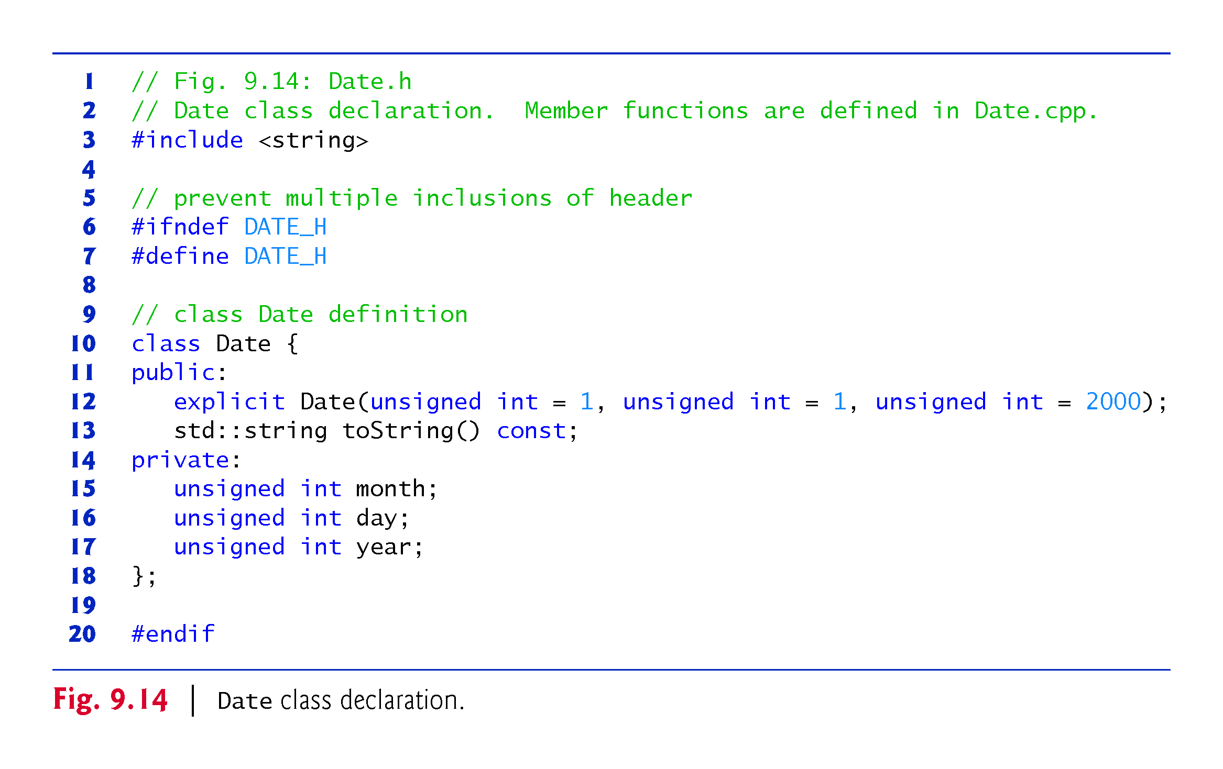

Slide 48
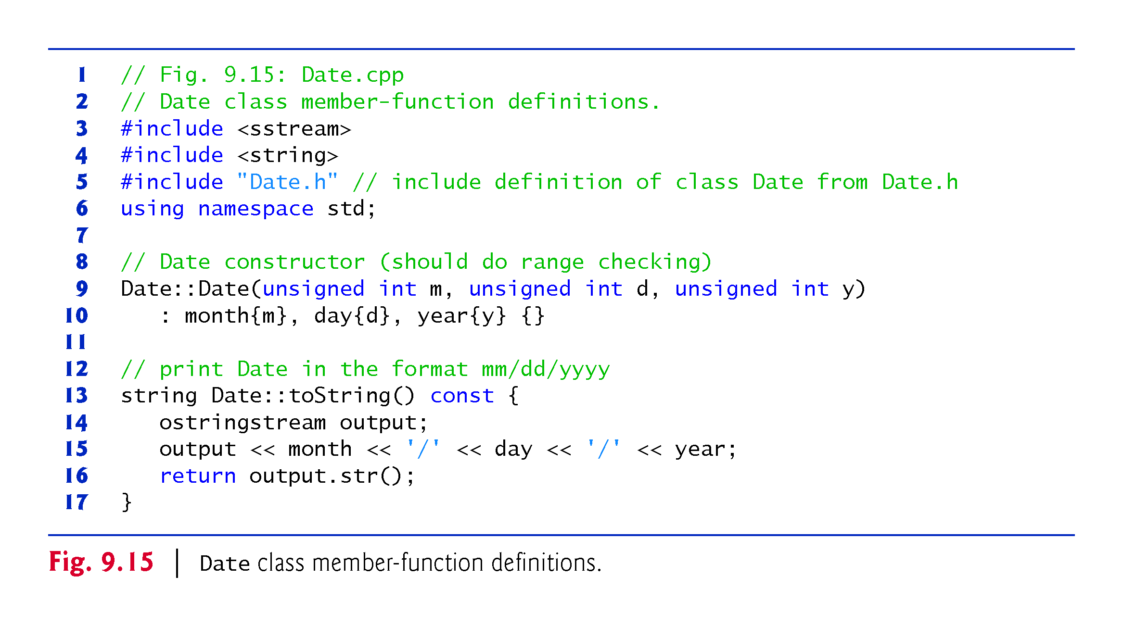

Slide 49
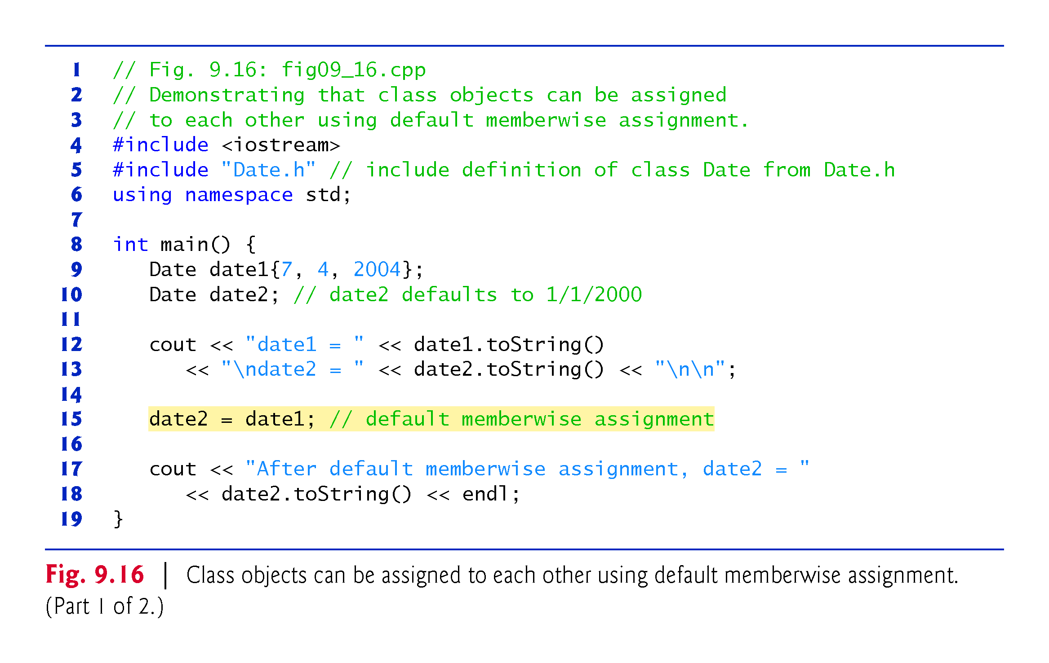

Slide 50
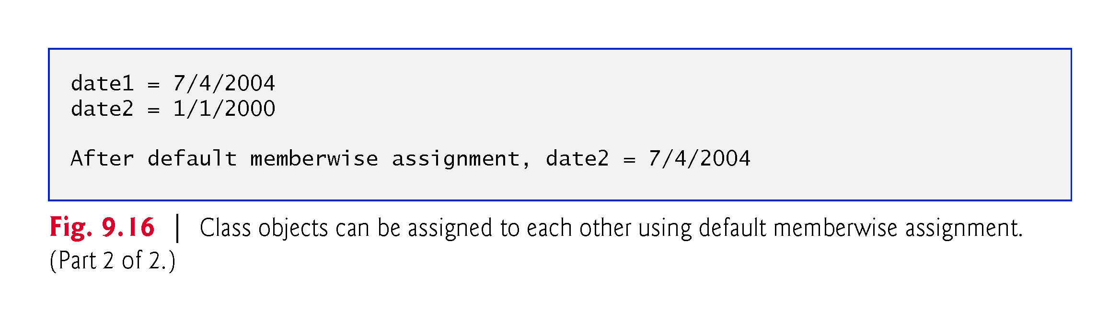

Slide 51
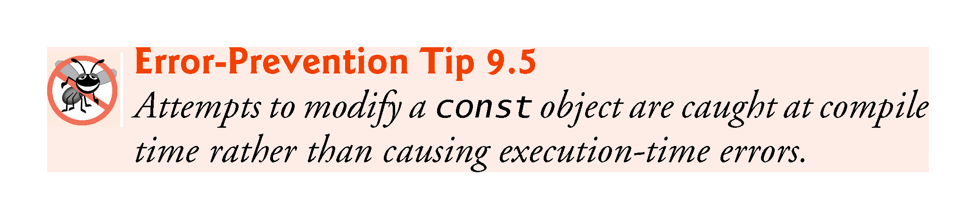

Slide 52
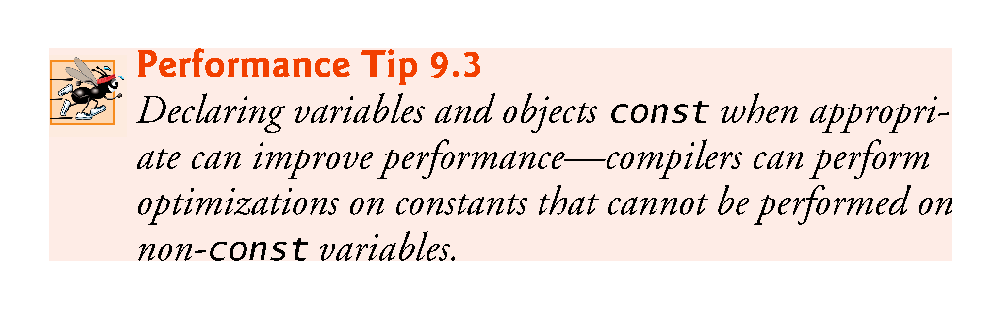
Notes:
Ob: Constants in for loops and how the compilers process them

Slide 53


Slide 54


Slide 55

Notes:
Ob: Error – Function toStandardString is also a constant function

Slide 56

Notes:
Ob: Can not bind the this pointer of constant Time objects to the address of the called function – of type Time&

Slide 57

Notes:
Ob: Private data members are constructed before the object of their class type is constructed.

Slide 58


Slide 59


Slide 60


Slide 61

Notes:
Ob: Mistake. In the if condition is daysPerMonth[month+1]. Explain order of evaluation for leap year

Slide 62

Notes:
Ob: Composition – object with member objects

Slide 63


Slide 64


Slide 65


Slide 66


Slide 67

Notes:
Ob: In composition its good to include multiple header files for clarity

Slide 68

Notes:
Ob: Component objects are destroyed before initial date objects in main program. Implicit construction but explicit destruction

Slide 69


Slide 70


Slide 71


Slide 72


Slide 73


Slide 74


Slide 75


Slide 76


Slide 77


Slide 78


Slide 79


Slide 80


Slide 81


Slide 82


Slide 83


Slide 84


Slide 85

Notes:
Ob: error – function declaration for standard time is missing

Slide 86

Notes:
Ob: Cascaded function calls is calling one function after the other – all called functions should return this pointers, Every retuned this pointer is binded to the address of the next function

Slide 87


Slide 88


Slide 89


Slide 90


Slide 91


Slide 92


Slide 93


Slide 94


Slide 95


Slide 96


Slide 97


